Slide 1


Towards an Integration of Free Recall and Serial Recall:
Examining a free recall account of transposition error gradients
in serial recall
Geoff Ward
University of Essex, UK

Slide 2
A: Introduction
Immediate Free Recall (IFR)
Recall in ANY order
Large extended recency effect
Smaller primacy effect
Immediate Serial Recall (ISR)
Recall in SAME order
Large extended primacy effect
Smaller recency effect
SOURCE: Grenfell-Essam & Ward (2012, JML)

Slide 3
A: Introduction
Immediate Free Recall (IFR) and Immediate Serial Recall (ISR)
1. IFR and ISR are widely-used and highly influential memory tasks.
2. IFR and ISR share similar methods
3. IFR and ISR share common theoretical heritage
Classic ‘signatures’ of limited-capacity short-term memory (STS)
Recency effect in IFR due to STS
Memory span in ISR due to STS

Slide 4
A: Introduction
4. Historically, IFR and ISR often explained by very different theories
Many classic theories of immediate serial recall do not account for IFR
Baddeley and Hitch (1974); Baddeley (1986, 2000, 2007); Brown, Preece, and Hulme (2000); Burgess and Hitch (1992, 1999, 2006); Farrell and Lewandowsky (2002, 2008); Henson (1998); Nairne (1990); Oberauer and Lewandowsky (2008); Page and Norris (1998)
Many classic theories of immediate free recall do not account for ISR
Davelaar, Goshen-Gottstein, Ashkenazi, Haarmann, & Usher (2005); Gillund & Shiffrin (1984); Howard and Kahana (2002); Laming (2006, 2008, 2009, 2010); Lehman & Malmberg (2013); Lohnas, Polyn, & Kahana (2015); Polyn, Norman, and Kahana (2009); Sederberg, Howard and Kahana (2008); Raaijmakers and Shiffrin (1981); Tan and Ward (2000)

Slide 5
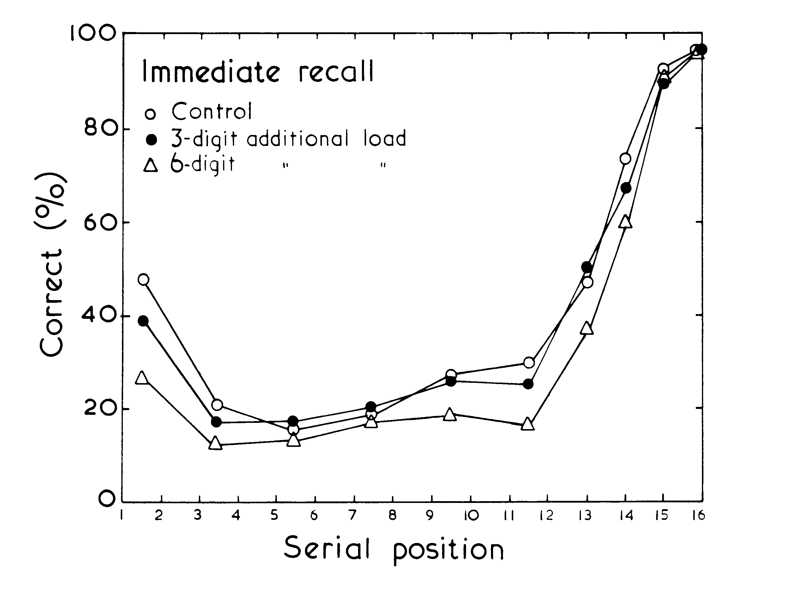
B: Why are there separate theories of ISR and IFR?
Three reasons:
Baddeley & Hitch (1974) excluded recency from WM
Recency effect in IFR survives concurrent 6-digit ISR load
“Most theories of STM assume that retrieval from a temporary buffer store accounts for the recency effect, whereas our own results argue against this view. It is suggested that working memory, which in other respects can be regarded as a modified STS does not provide the basis for recency” (B&H, 1974. p81)

Slide 6
B: Why are there separate theories of ISR and IFR?
Three reasons:
(2) Baddeley (1976) Speech-based variables affect ISR but not recency
Phonological Loop theory of ISR
    phonological similarity effects
    word length effects
    articulatory suppression
    irrelevant speech effects
but recency effects in IFR not selectively affected by these variables

Slide 7
B: Why are there separate theories of ISR and IFR?
Three reasons:
(3) Theories of ISR dominated by explaining primacy effects
Theories of IFR dominated by explaining recency effects
SOURCE: Grenfell-Essam & Ward (2012, JML)

Slide 8
C: The need for theoretical unification:
Three reasons:
I: Similar Encoding
II: Similar effects of speech variables
III: Similarities with similar List length and scoring systems

Slide 9
I: Similar Encoding
Bhatarah, Ward and Tan (2008, M&C)
Three groups of participants
Group 1: Pre-cued Serial recall – they always performed ISR
Group 2: Pre-cued Free recall – they always performed IFR
Group 3: Post-cued Group: Encoded words not knowing
Cued at test to perform IFR (post-cued IFR) OR
Cued at test to perform ISR (post-cued ISR)

Slide 10
Immediate Serial Recall
Immediate Free Recall
SOURCE: Bhatarah, Ward and Tan (2008, M&C)

Slide 11
C: The need for theoretical unification:
Three reasons:
I: Similar Encoding
II: Similar effects of speech variables
III: Similarities with similar List length and scoring systems

Slide 12
II: Similar effects of speech variables
Both ISR and IFR are similarly affected by speech-based variables
  Phonological similarity effect (Spurgeon, Ward & Matthews, 2014a)
  Word length effect (Bhatarah, Ward, Hayes, & Smith, 2009)
  Articulatory suppression (Bhatarah, Ward, Hayes, & Smith, 2009)
Both ISR and IFR are similarly affected by
  Presentation rate (Tan & Ward, 2008; Grenfell-Essam, Ward & Tan, 2013)
  Temporal Isolation effects (Grenfell-Essam, Ward & Cortis Mack, 2019)
  Modality effects (Grenfell-Essam, Ward & Tan, 2017)

Slide 13
Bhatarah, Ward, Smith & Hayes (2009)
Immediate Serial Recall is affected by word length
Is Immediate Free Recall similarly affected by word length?
Immediate Serial Recall
Immediate Free Recall

Slide 14
Bhatarah, Ward, Smith & Hayes (2009)
Immediate Serial Recall is affected by word length
Is Immediate Free Recall also affected by word length?
Immediate Serial Recall
Immediate Free Recall

Slide 15
Bhatarah, Ward, Smith & Hayes (2009, M&C)
Immediate Serial Recall is affected by word length
Is Immediate Free Recall also affected by word length?
Immediate Serial Recall
Immediate Free Recall

Slide 16
C: The need for theoretical unification:
I: Similar Encoding
II: Similar effects of speech variables
III: List length and scoring systems

Slide 17
The importance of List lengths and scoring systems
Ward Tan & Grenfell-Essam (2010)
IFR typically tested with long lists
ISR typically tested with shorter lists
The List Length affects which word is recalled first…..
....and which word is recalled first affects serial position curve...
ISR and IFR more similar using same length and scoring system

Slide 18
Ward, Tan and Grenfell-Essam (2010; JEP:LM&C)

Slide 19
Ward, Tan and Grenfell-Essam (2010; JEP:LM&C)
EXPERIMENT 1
55 Participants presented with 45 trials for free recall
Three trials each of List lengths 1-15
List length random, unknown in advance to participants, 1 second per word
Serial position curves

Slide 20
Ward, Tan and Grenfell-Essam (2010; JEP:LM&C)
EXPERIMENT 1
55 Participants presented with 45 trials for free recall
Three trials each of List lengths 1-15
List length random, unknown in advance to participants, 1 second per word
Serial position curves
List Length

Slide 21
Ward, Tan and Grenfell-Essam (2010; JEP:LM&C)
EXPERIMENT 1
55 Participants presented with 45 trials for free recall
Three trials each of List lengths 1-15
List length random, unknown in advance to participants, 1 second per word
Probability of first recall
List Length

Slide 22
Ward, Tan and Grenfell-Essam (2010; JEP:LM&C)
EXPERIMENT 1
55 Participants presented with 45 trials for free recall
Three trials each of List lengths 1-15
List length random, unknown in advance to participants, 1 second per word
Probability of first recall
List Length

Slide 23
Ward, Tan and Grenfell-Essam (2010; JEP:LM&C)
EXPERIMENT 1
55 Participants presented with 45 trials for free recall
Three trials each of List lengths 1-15
List length random, unknown in advance to participants, 1 second per word
Probability of first recall
List Length
Output first item first

Slide 24
Ward, Tan and Grenfell-Essam (2010; JEP:LM&C)
EXPERIMENT 1
55 Participants presented with 45 trials for free recall
Three trials each of List lengths 1-15
List length random, unknown in advance to participants, 1 second per word
Probability of first recall
List Length
Output Last 4 first

Slide 25
Ward, Tan and Grenfell-Essam (2010; JEP:LM&C)
EXPERIMENT 1
55 Participants presented with 45 trials for free recall
Three trials each of List lengths 1-15
List length random, unknown in advance to participants
Probability of first recall
Output first item first
Output Last 4 first

Slide 26
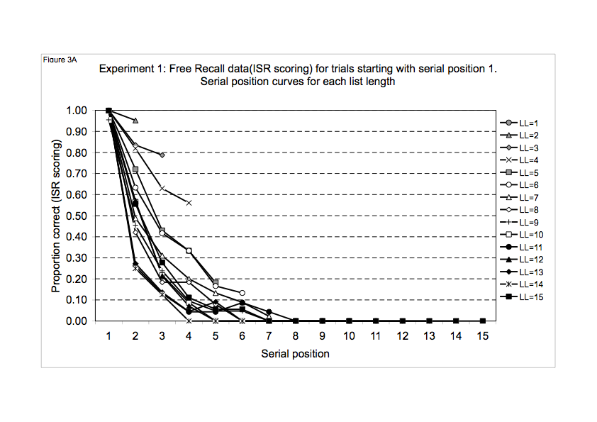
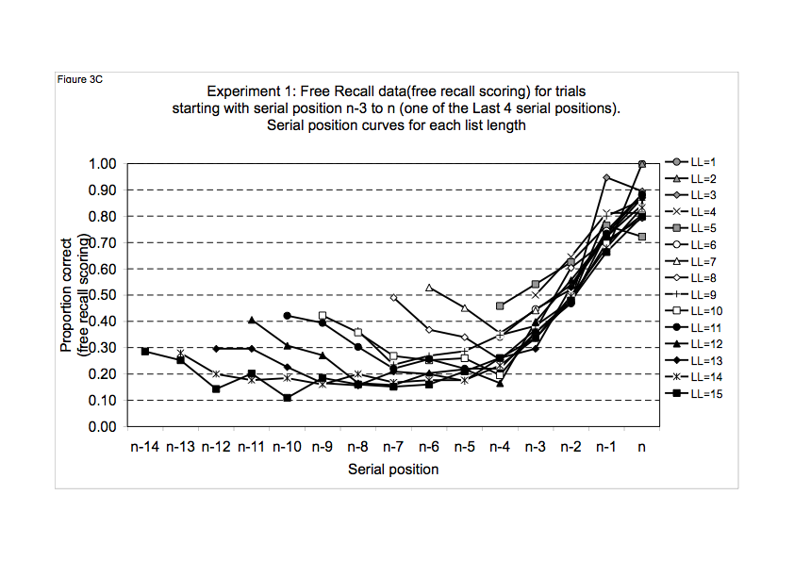
Output first item first
Output Last 4 first
Ward, G., Tan, L., & Grenfell-Essam, R. (2010). Examining the relationship between free recall and immediate serial recall: the effects of list length and output order. Journal of Experimental Psychology: Learning, Memory, & Cognition, 36,1207-1241.

Slide 27
Output first item first
Output Last 4 first
For short lists, see some “ISR-like” properties of free recall:
For short lists, tend to start with SP 1, recall in forward order.
At longer lists - tend to start with recency, some forward-ordered recall.
Ward, G., Tan, L., & Grenfell-Essam, R. (2010). Examining the relationship between free recall and immediate serial recall: the effects of list length and output order. Journal of Experimental Psychology: Learning, Memory, & Cognition, 36,1207-1241.
Notes:
27

Slide 28
Ward, Tan & Grenfell-Essam (2010)
If asked to recall in any order:
“hat, mouse, tea, stairs”,
participants often respond
“hat, mouse, tea, stairs”
That is,
Participants tend to perform immediate free recall (IFR) of short lists in an “immediate serial recall (ISR)-like” manner.

Slide 29
Grenfell-Essam and Ward (2012, E3)
Three groups
Pre-cued Free recall (IFR)
Pre-cued Serial Recall (ISR)
Post-cued: at end of list
    “ANY” --post-cued IFR
    “SAME” --post-cued ISR
Vary list length:
LLs = 2, 4, 5, 6, 7, 8,10,15
SOURCE: Grenfell-Essam and Ward (2012, JML)

Slide 30
The importance of List lengths and scoring systems
SOURCE: Grenfell-Essam and Ward (2012, JML)

Slide 31
The importance of List lengths and scoring systems
COMPARE SAME RANGE OF LIST LENGTHS
SERIAL POSITION CURVES LOOK MORE SIMILAR
SOURCE: Grenfell-Essam and Ward (2012, JML)

Slide 32
The importance of List lengths and scoring systems
COMPARE SAME SCORING & LIST LENGTHS
SERIAL POSITION CURVES LOOK MORE SIMILAR
SOURCE: Grenfell-Essam and Ward (2012, JML)

Slide 33
The importance of List lengths and scoring systems
COMPARE PRE-CUED CURVES
SOURCE: Grenfell-Essam and Ward (2012, JML)

Slide 34
The importance of List lengths and scoring systems
COMPARE POST-CUED CURVES
SOURCE: Grenfell-Essam and Ward (2012, JML)

Slide 35
Overview
A: Introduction to Immediate Free Recall (IFR)
Immediate Serial Recall (ISR)
B: Why are there separate theories of IFR and ISR?
C: The need for theoretical unification:
I: Similar Encoding
II: Similar effects of speech variables
III: List length and scoring systems
D: Toward theoretical integration between IFR and ISR:
Start and End sequences and Error transpositions
E: Summary and Conclusions

Slide 36
D: Toward theoretical integration between ISR and IFR
Privileged access to SP1 (decreases with LL)
Imagine that participants try to learn a start sequence…
start at SP1 and continue SP1>SP2->SP3->SP3
if SP1 retrieved then can recall start sequence
Privileged access to Last 4
Imagine at test, participants have good access to last few items
start at SPn-3 to n and continue forward in end sequence

Slide 37
D: Toward theoretical integration between ISR and IFR:
Can plot serial position curves of start and end sequences
List Length Stimuli Recalls
8-item list ABCDEFGH FGHCABG,
HGABCE,
GFAC
4-item list ABCD ABCD,
BDA,
DABC,
DCBA
15-item list ABCDEFGHIJKLMNO NODACG,
LMNOCA,
NOMABC

Slide 38
D: Toward theoretical integration between ISR and IFR
Serial position curves of start and end sequences…
Similar bowed serial position curves for start and end sequences IFR and ISR
SOURCE: Grenfell-Essam and Ward (2012, JML)

Slide 39
D: Toward theoretical integration between ISR and IFR
Tentative Hypothesis:
Suppose the only serial position information known in ISR (or IFR) is the start-sequence and the end-sequence;
[if so, in ISR all other recalled items are recalled in random positions in between start and end sequences].
But can this be correct? The case of Error Transposition Gradients

Slide 40
Error transposition gradients
In ISR, recalled items are output in either the correct or near-neighbor serial position -> some SP info known about all items?
Correct & Error positions in ISR
Error-only positions in ISR
Frequency of responses
Proportion of order errors
Output position
Output position
DATA: OSTH & DENNIS (2015, JEP:LM&C)

Slide 41
GEOFF WARD 2297
Solution?
Because start sequences and end sequences are known, the positions of other recalled items will be constrained.
without any other serial order information?
Recalled seq. Start seq + other recalled items ordered randomly + end seq
ABCEDF ABC + ED or DE + F
ABDEF AB + + DEF
BACDEF + BA or AB + CDEF
ACDE A + CDE or CED or DCE or DEC or ECD or EDC +
ADCEF A + DC or CD + EF
ABCDGF ABCD + G + F
ABDCEF AB + DC or CD + EF
ABCBDF ABC + BD or DB + F
Could these constraints generate transposition error gradients?
DATA: OSTH & DENNIS (2015, JEP:LM&C)

Slide 42
Test:
Osth and Dennis (2015)
Sequences of six words for ISR. Rate of 1.25 s per word; typed recall.
  Open ISR: words always different
  Open RoO: Reconstruction of Order,
  words re-presented in different order at test
  Open ISR-blank: words always different,
  participant types “blank” to skip position
  Closed ISR: same words every trial
DATA: OSTH & DENNIS (2015, JEP:LM&C)

Slide 43
DATA: OSTH & DENNIS (2015)

Slide 44
Very similar
Error gradients
Observed data
Similar to
Start+random+end
estimates
DATA: OSTH & DENNIS (2015)

Slide 45
OPEN SET DATA
OPEN SET START-END ESTIMATE
CLOSED SET DATA
CLOSED SET START-END ESTIMATE

Slide 46
OPEN ISR BLANKS DATA
OPEN ISR BLANKS START-END ESTIMATE
RoO DATA
RoO START-END ESTIMATE

Slide 47
E: Summary and Conclusions
There is a need for theoretical unification of ISR and IFR.
I: Similar Encoding but different retrieval strategies
II: Similar effects of different variables on ISR and IFR
III: Similarities increase when List length and scoring systems = same
Both tasks generate start sequences and end sequences (and other items)
We can use free recall sequences to explain serial recall phenomena.
If we know start sequences and end sequences, then randomly allocating any other recalled items in between will naturally generate transposition error gradients.

Slide 48
Thank you!
Any Questions?
Acknowledgements
Talented PhD students
Lydia Tan
Parveen Bhatarah (ESRC)
Rachel Grenfell-Essam (ESRC)
Jessica Spurgeon
Cathleen Cortis Mack

