Slide 1
Combined Orientation 2026
Graduate Diploma in Psychology - 340AA
Honours in Psychology
Graduate Diploma in Psychology (Advanced)
Masters in Applied Psychology
Master Professional Psychology
Melbourne School of Psychological Sciences
Faculty of Medicine, Dentistry and Health Sciences

Slide 2

Essential Enrolment Information

Slide 3
Information covered
Key websites and resources: my.unimelb, Handbook, LMS
Services at Stop 1
Course Advice
Building Access
Note: The slides will be made available on current student intranet http://psychologicalsciences.unimelb.edu.au/study/

Slide 4
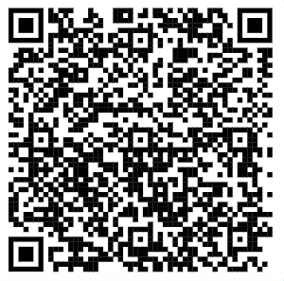
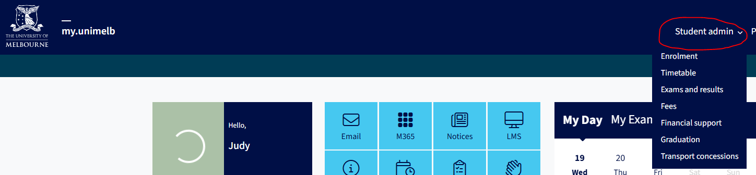
Key Websites & Resources – my.unimelb
My.unimelb student
portal: https://my.unimelb.edu.au/
View your study plan, enrol and withdraw subjects
Access your personal details
Access your timetable, results, fees and more under the Student Admin tab
https://students.unimelb.edu.au/your-course/your-personal-details/change-to-personal-details

Slide 5
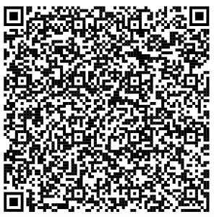
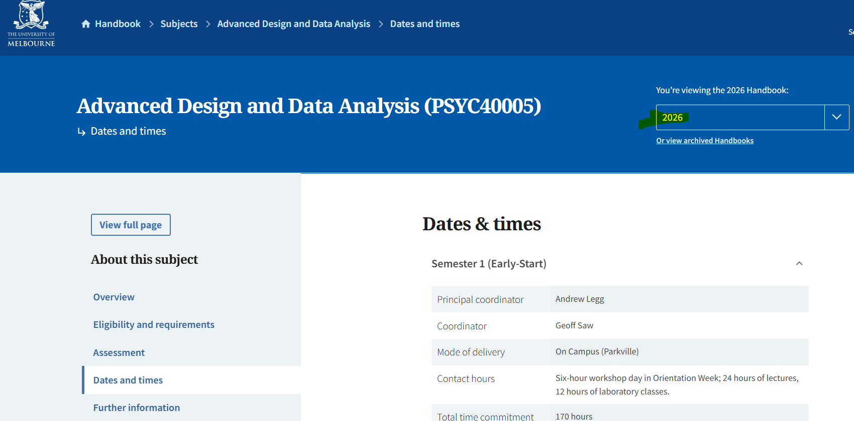
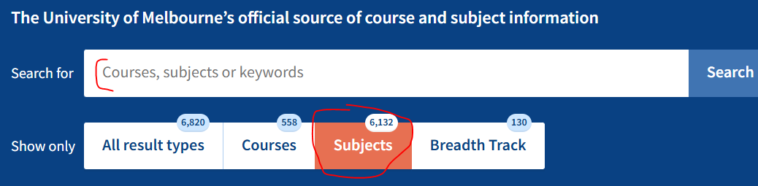
Key Websites & Resources Handbook
https://handbook.unimelb.edu.au
Handbook:
Course structure
Key enrolment dates (e.g., Census date)
Assessment information
Subject coordinator contact information

Slide 6
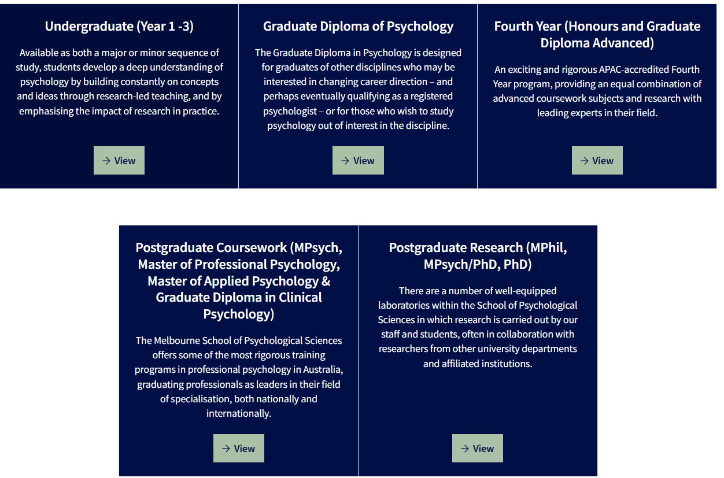
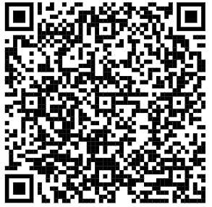
Key Websites & Resources cont’d
MSPS current student website
(Melbourne School of Psychological
Sciences)
Student manuals
Student forms (e.g., booking rooms)
Administrative procedures
http://psychologicalsciences.unimelb.edu.au/study/
Unimelb student login required

Slide 7
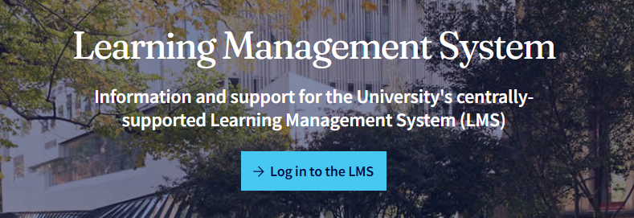
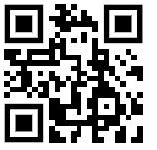
Key Websites & Resources - LMS
Learning Management System (Canvas)
Subject contents & readings
Subject updates from subject
coordinators/tutors
Submit assignments
https://lms.unimelb.edu.au/

Slide 8
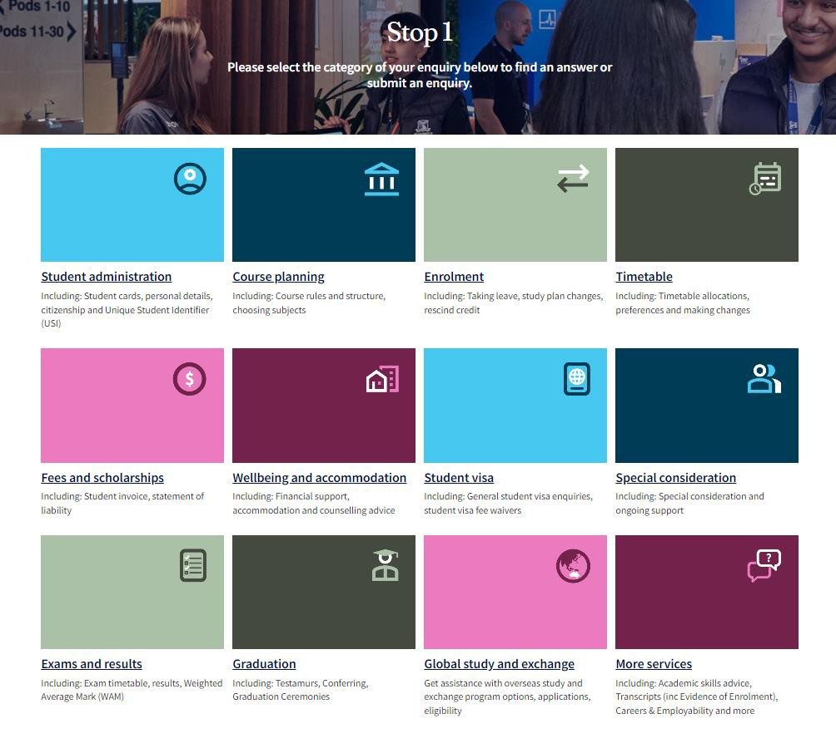
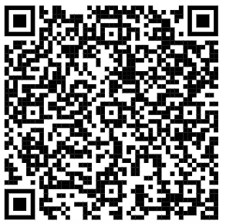
https://students.unimelb.edu.au/student-support/advice-and-help/stop-1

Slide 9
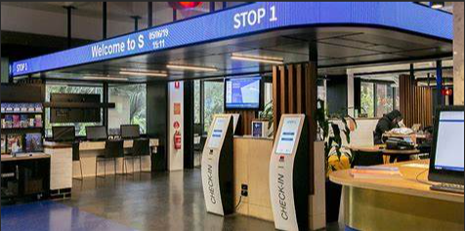
Student Support Services – Stop 1
Connecting students and services – Stop 1
Book an appointment with the relevant team – virtual or in person, or Submit an enquiry on website
Website: Stop 1 : Student advice : University of Melbourne (unimelb.edu.au)
Ph: 13 MELB (13 6352)
Location: 757 Swanston St, Parkville, (Corner Grattan St and Swanston St) Monday – Friday 9am – 5pm
FAQs: http://ask.unimelb.edu.au/, covering topics: Student cards, enrolment, timetabling, CoE and student visa, fees, special consideration, student equity and disability, housing etc.
Notes:
Stop 1 is the home of student services online, on the phone and in person.
Student cards, fees, special consideration and student equity, disability, housing, etc.

Slide 10
Support Services and Key Information
Census Dates: It is your responsibility to be aware of key enrolment and withdrawal dates. Refer to Handbook for relevant dates.
Extension (up to 10 working days) and Special Consideration (unexpected circumstances and ongoing support): The University has policies and procedures in place if you need support: https://students.unimelb.edu.au/your- course/manage-your-course/exams-assessments-and-results/special-consideration
Counselling Services: http://services.unimelb.edu.au/counsel
Student Advocacy:
https://umsu.unimelb.edu.au/support/advocacy/specialconsideration-feeremission/special-consideration/
Health Services:
http://services.unimelb.edu.au/health
Notes:
Census Dates: Dates listed on my.unimelb and in the handbook entry for each subject. It is your responsibility to be aware of key enrolment and withdrawal dates.
Special Consideration: You may experience unexpected circumstances that significantly impact your studies, or you may experience ongoing health conditions, or official commitments that require study adjustments to assist you. The University has policies and procedures in place if you need support: http://students.unimelb.edu.au/admin/special
Student Advocacy and Health Services: The Student Advocacy Service can provide help and discuss the options that might be available if you need to apply, or have applied for, Special Consideration. The University's Health Service and Counselling and Psychological Services are available to all students.

Slide 11
Course Advice
Course advice
For advice on course entry and degree structure, please submit your initial enquiry to Stop 1 first to seek their advice.
If you require further assistance, you can contact the relevant Academic Programs Team via email:
graddip-psych@unimelb.edu.au : Graduate Diploma of Psychology (340AA)
fourthyear-psych@unimelb.edu.au : All Psychology Honours
Postgrad-psych@unimelb.edu.au : All Master students
Correspondence
Always include your student ID number and use your student email account to contact us.
All official University correspondence will be sent to your UoM email only, so check your emails regularly.

Slide 12
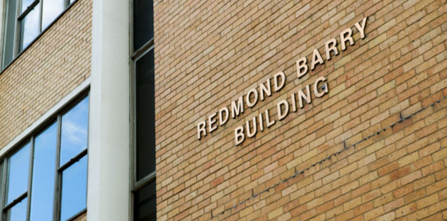
Building Access
Grad Dip of Psychology and Psychology Honours Students
General Building access: 8am-5.30pm
    Graduate Resources Room (10th floor) Redmond Barry Building
Master of Applied Psychology and Professional Psychology Students
General Building access: 8am-5.30pm
    Graduate Resources Room (10th floor)
    Staff & Postgraduate tearoom (12th floor) Redmond Barry Building
    *Students who wish to gain After-hours and weekend access outside general access, please contact
    enquiry-psych@unimelb.edu.au
Please ensure that you order your student card online: http://students.unimelb.edu.au/admin/student-card
Reception located Level 12 Redmond Barry Building, open Monday to Friday 9am-5pm. Except Wednesday

Slide 13
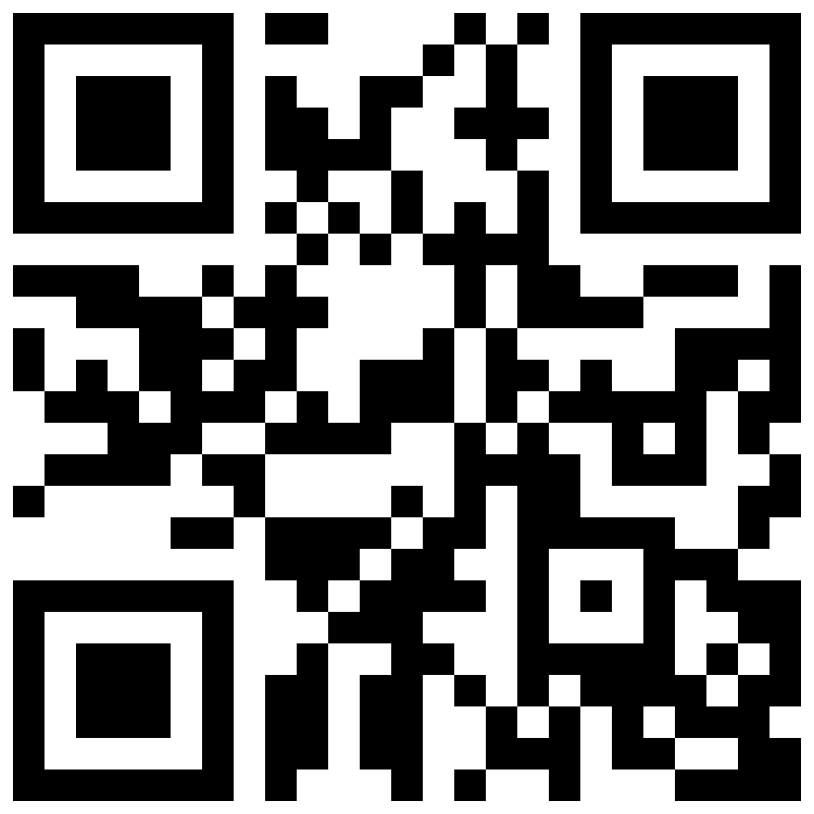
Keeping in touch with the School
Subscribe to our newsletter
Stay informed with news, events and collaborative opportunities – visit our website, find us on social media or scan the QR code to subscribe to our newsletter.
psychologicalsciences.unimelb.edu.au/engage
The University of Melbourne (Australian University) PRV12150/CRICOS 00116K

Slide 14
Thank You
The University of Melbourne (Australian University) PRV12150/CRICOS 00116K

