Slide 1

Welcome to the Research Experience Program (REP)
For more info, visit: http://go.unimelb.edu.au/j77r

Slide 2
Aims of the REP
Pedagogical (a): To provide undergraduate psychology students a first-hand understanding of empirical psychology research from the participant’s perspective
Pedagogical (b): To provide postgraduate and fourth-year students with appropriate training in research ethics and management, by conducting research under the direct supervision of experienced academic researchers
Research: To provide staff and student researchers within the School an avenue for recruiting research participants

Slide 3






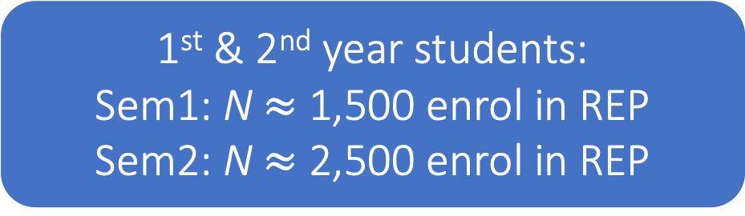
Research Experience Program
1st & 2nd year students:
Sem1: N $≈$ 1,500 enrol in REP
Sem2: N $≈$ 2,500 enrol in REP
Researchers
N $≈$ 250
1st Year (REP1): Max. 5 hours per subject
1 hour = 1% course credit
MPsych + 4th Year: 80 hours per semester
PhD + Staff: 100 hours per semester
2nd Year (REP2): Max. 2.5 hours
1 hour = 2% course credit

Slide 4
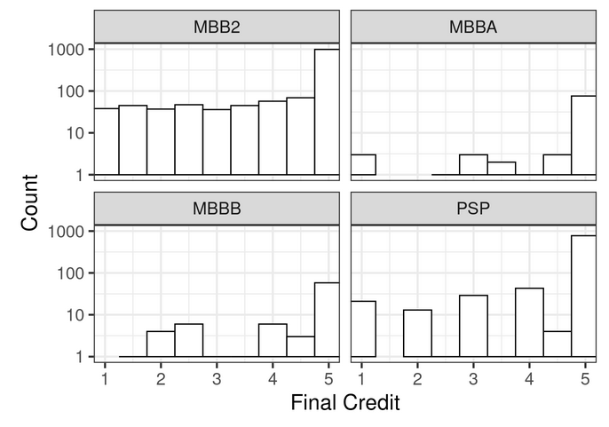
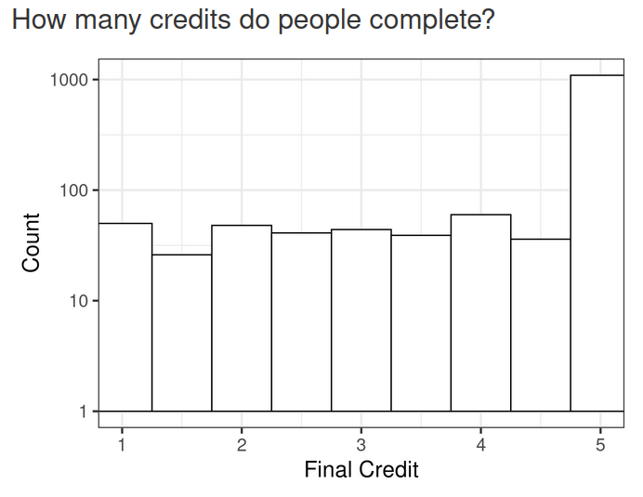
REP usage stats, 2025
Semester 2:
986 MBB2s completed
5 REP hours
Total = >15,000 REP participant hours
Semester 1:
1093 MBB1s completed
5 REP hours
Semester 2:
774 2nd Years completed
2.5 REP hours

Slide 5
What you need to do
Step 1
Decide (with your supervisor) if you’ll be using the REP for your research project ASAP
Ask yourself:
pedagogical value?
ethical?
feasible?
Step 2
Design your study with REP recruitment in mind.
Tips:
keep it simple
make it interesting
ensure study duration is commensurate with proposed REP credits
REP1 studies: 0.5 to 3 hours
REP2 studies: 0.5 to 2.5 hours
Step 3
Apply for ethics approval
Tips:
clearly mention recruitment via REP. Use broad wording to cover REP1 & REP2
Note: studies can run concurrently in REP1 & REP2 in Semester 2
under-18s can consent if appropriate and explicitly stated in ethics app

Slide 6
What you need to do
Step 4
Request an REP researcher account by emailing REP-psych@unimelb.edu.au
Include in your email:
Subject: request new researcher account
Body: full name; UoM username; email; supervisor name
Step 5
Log in to SONA Systems
https://unimelb.sona-systems.com/
Tips:
don’t log in before your researcher account is created!
use your UoM credentials to login via SSO
Step 6
Create your REP study, add researchers/PIs, add timeslots, set your study to active
Tips:
make it interesting!
avoid in/exclusion criteria
keep descriptions brief and simple

Slide 7
 | SUB-OPTIMAL | BETTER
Study Name | An Experimental Study on the Influence of Music Genres on Mood Induction and Memory Performance in Psychology Undergraduates | Music, Mood, and Memory
Brief Abstract | Participants will engage in an experiment investigating the effects of various musical genres on mood induction and memory performance. Participation involves standardized procedures and data collection methods in adherence with research protocols. | In this study, you’ll be asked to listen to music and then report how you feel and complete some memory tasks.
Description | Participants will engage in an experiment investigating the effects of various musical genres on mood induction and memory performance. Through controlled exposure to music stimuli and subsequent memory tasks, researchers aim to elucidate the impact of music on cognitive processes. The study seeks to contribute to the scientific understanding of the relationship between music, affective states, and memory retention. Participation involves standardized procedures and data collection methods in adherence to research protocols. | Join our ground-breaking study on the fascinating interplay between music, mood, and memory! Discover how different genres of music can shape your emotional state and enhance your memory performance. Immerse yourself in a captivating experiment where you'll listen to diverse musical excerpts while engaging in fun memory tasks. Your participation will not only contribute to scientific knowledge but also provide you with unique insights into your own cognitive processes. Don't miss this opportunity to explore the power of music on your mind!

Slide 8
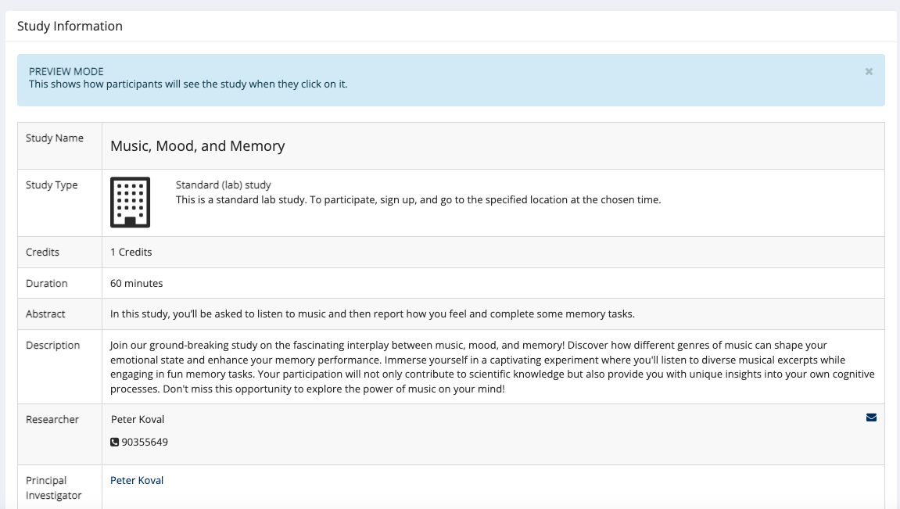
What participants see

Slide 9
What you need to do
Step 7
Email REP-psych@unimelb.edu.au
to request your new study to be activated
You MUST mention:
Name of your study
How many REP hours each researcher is contributing
Attach your ethics
CC all researchers
Step 8
Recruit participants and collect data
Tips:
check SONA systems regularly for new sign-ups
communicate promptly and politely with participants
assign REP credits quickly
(< 48 hours)
Step 9
Prepare a report of your findings for posting online at the end of each semester
For examples, see: http://go.unimelb.edu.au/9b8i

Slide 10
REP is a precious resource
Collecting data through REP is a privilege
As a (trainee) researcher, you are bound by ethical principles and responsibilities
Give REP participants the benefit of the doubt
Our admin staff work hard to make REP run, please be patient
For help with creating your REP study,
see pp. 26-103 of the user manual
and/or watch this video tutorial
Got questions / having problems?
REP-psych@unimelb.edu.au
More info at http://go.unimelb.edu.au/j77r

Slide 11
Step-by-step guide to setting up your REP study
NB: this example shows how to create a two-part study

Slide 12
STEP 1
DO YOU HAVE AN REP-RESEARCHER ACCOUNT
on SONA Systems?
YES
NO
PROCEED TO STEP 2
Send an email to rep-psych@unimelb.edu.au with
“request new honours researcher account” as the subject.
Please include:
-> your name;
-> student ID;
->name of supervisor
NB: if you already logged in before requesting an REP researcher account you may be registered in the REP system as a “participant” instead of a researcher. Please email rep-psych@unimelb.edu.au requesting to have your profile switched to “researcher”.

Slide 13
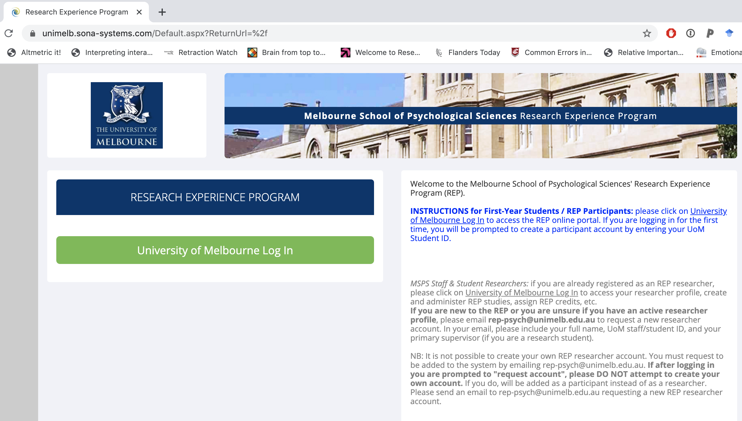
STEP 2
Log in to
SONA Systems
https://unimelb.sona-systems.com/

Slide 14
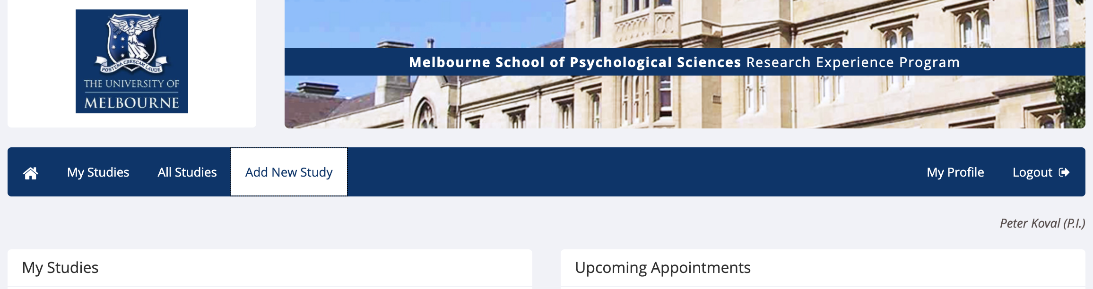
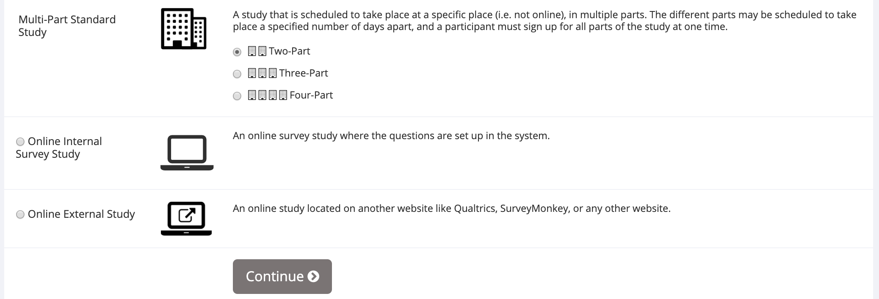
STEP 3
Click Add New Study
STEP 4
NB: in this example, I’ve selected Two-Part study
Select study type
Click “continue”

Slide 15
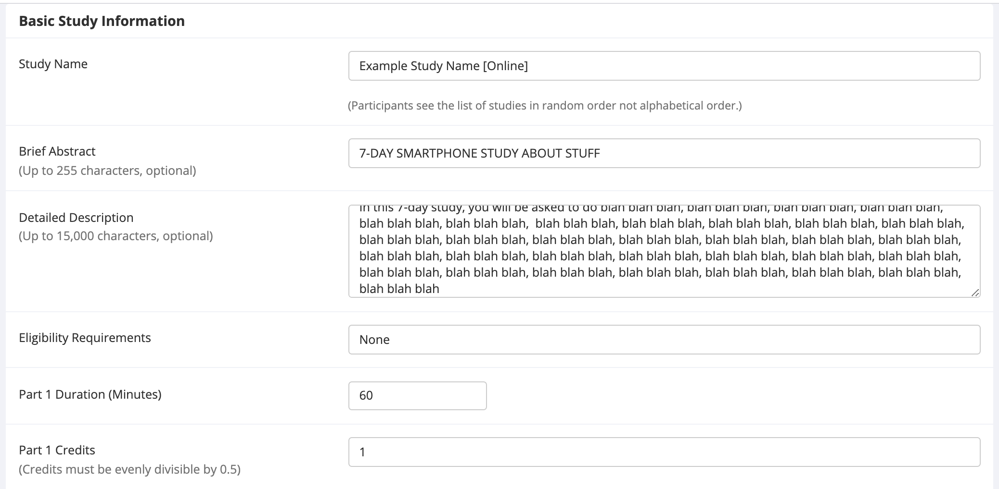
STEP 5
Add a study name, a brief abstract, and a longer description
STEP 6
Specify a duration and number of REP credits
Min = 0.5 credits
1 hour = 1 credit
**TIP: the total number of participants you can recruit depends on duration of both parts of your study + your REP quota.
Note: each semester, 4th year and MPsych students are eligible for 80 hours; PhD students and staff are eligible for 100 hours.
To combine multiple researchers’ REP hours, email REP-Psych@unimelb.edu.au and Cc everyone combining their hours to request your hours to be combined for a single study.

Slide 16
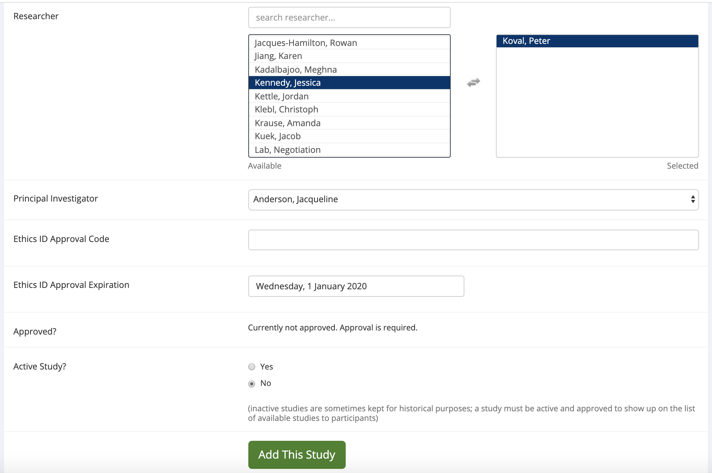
STEP 7
**TIP: for collaborative studies, add multiple researchers to allow multiple people to administer the study on SONA systems!
You can also combine the REP hours of multiple researchers (including the P.I.) by emailing REP-Psych@unimelb.edu.au
Add yourself as “Researcher” by moving your name
from “available” to “selected” using the arrows
STEP 8
Add your supervisor as “Principal Investigator” using the drop-down menu
STEP 9
Enter your ethics ID
and ethics expiry date
as listed on your ethics approval letter (ask your supervisor if unsure)
STEP 10
Select “yes” for “Active Study”
do NOT click “Add This Study” yet

Slide 17
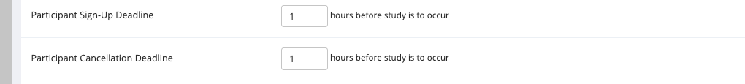
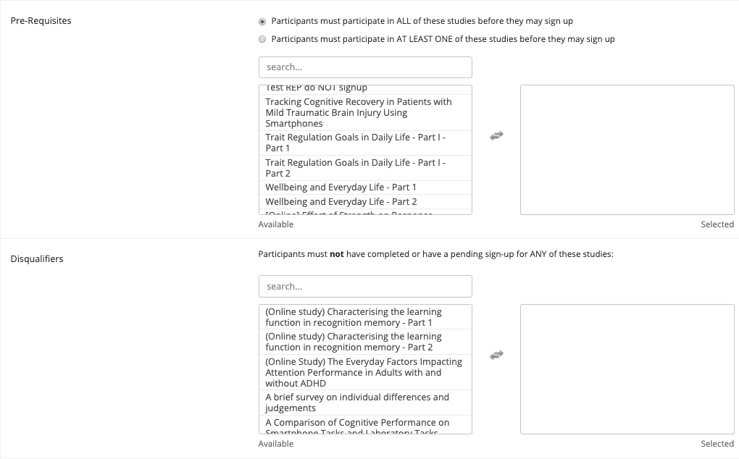
STEP 11
Scroll down to “Advanced Settings”
STEP 12
Check that the “Participant Sign-up Deadline”
and
“Participant Cancellation Deadline”
are set correctly.
Default setting is 24 hours, but if you want to start recruiting participants in 12 hours from now, you should set this to a smaller number or participants will not be able to sign up!
STEP 13 [optional]
You may also select other REP studies as “Pre-requisites” or “Disqualifiers”
[OPTIONAL]

Slide 18
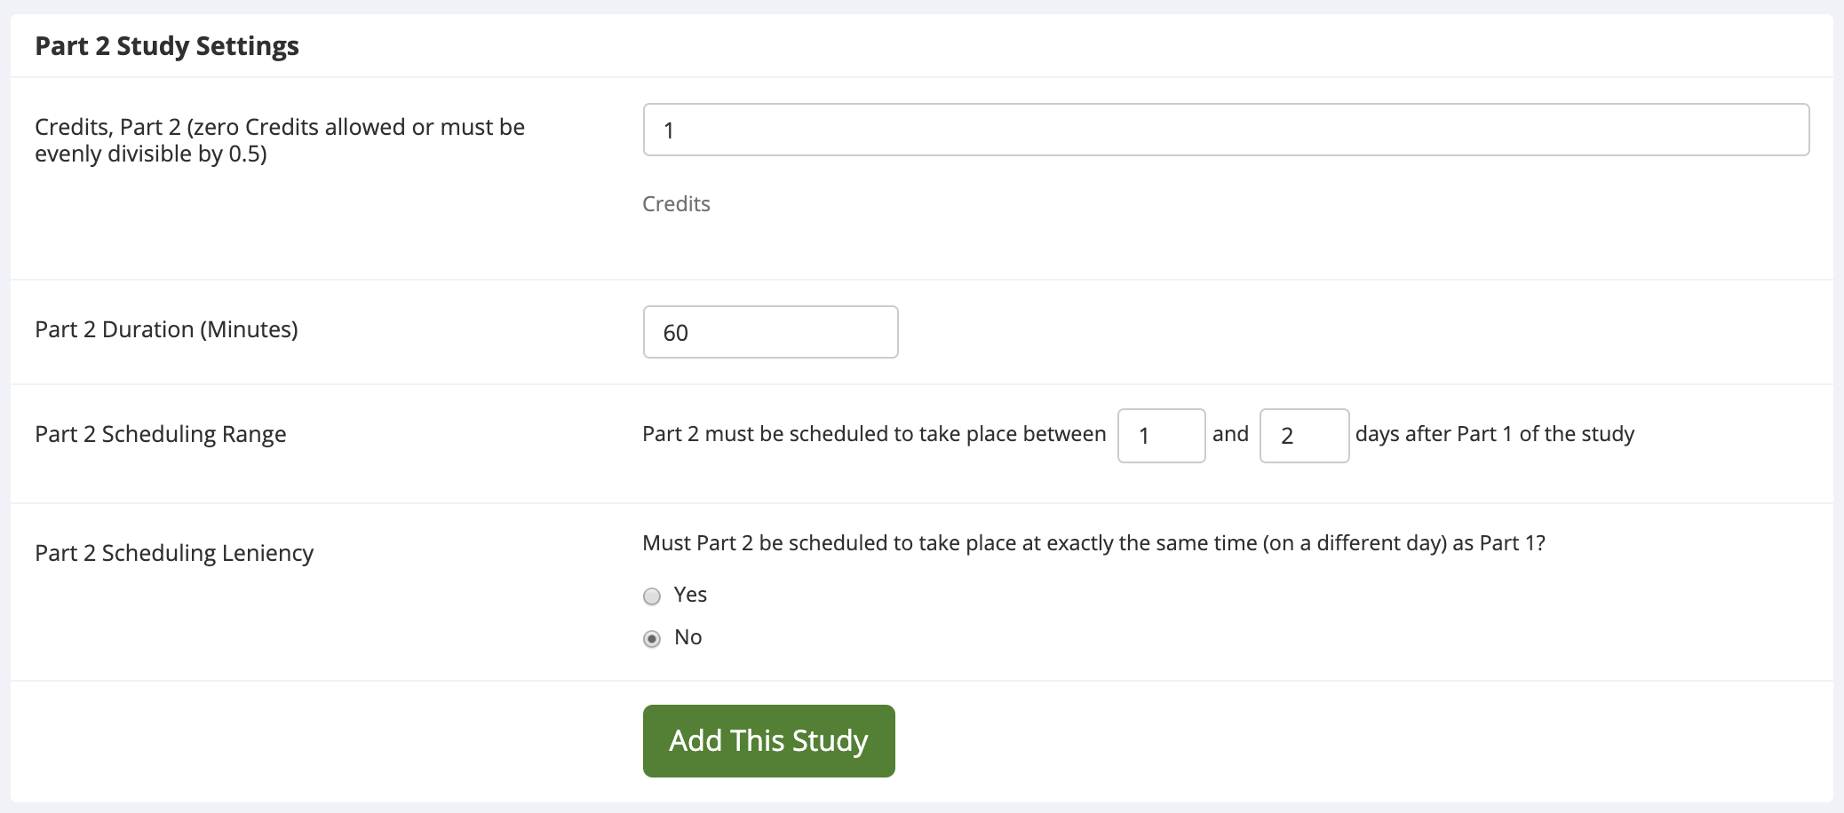
STEP 14
Scroll down to “Part 2 Study Settings”
STEP 15
Add number of credits
and duration for Part 2 (for multi-part studies)
STEP 16
Enter your desired values for “scheduling range”
and “scheduling leniency”
STEP 17
CLICK ”Add This Study”
Note that your study will not be visible to participants until (a) it is approved by REP admin/convenor; and (b) you add time-slots for participants to sign up to.

Slide 19
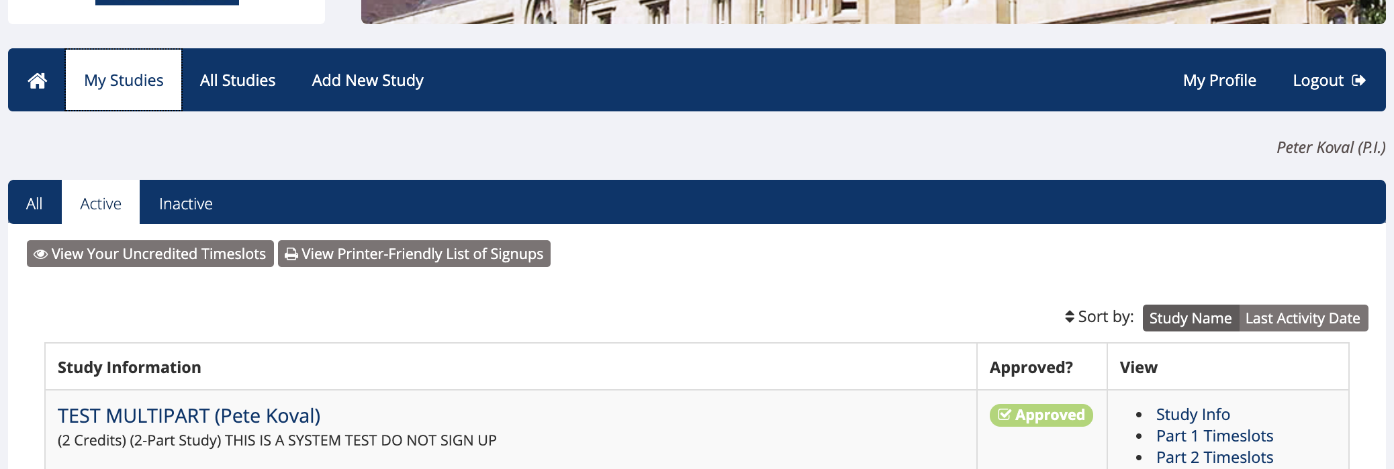
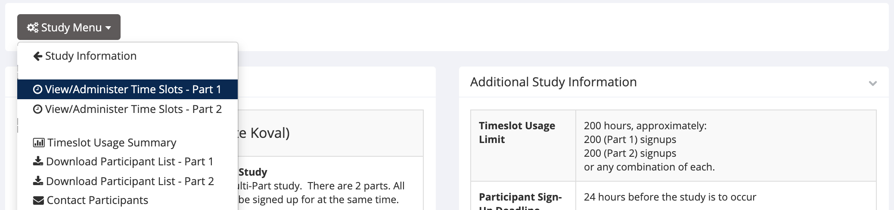
STEP 18
Go to “My Studies”
STEP 19
Click on the name of your new study
STEP 20
**TIP: the total number of hours that can be used for the study will be shown here. Only the REP administrator/convenor can edit this.
Email REP-Psych@unimelb.edu.au if you believe this is incorrect.
Click on “Study Menu” and select
“View/Administer Time Slots – Part 1”

Slide 20
STEP 21
Add single or multiple time-slots; TIP: adding multiple timeslots is easier/quicker
STEP 22
Adding Multiple Timeslots:
There are 2 options for adding multiple timeslots:
You may add a specified number of timeslots, or
you may duplicate the timeslot configuration from a specific week.
-> If you duplicate the timeslot configuration from a specific week, the number of participants, locations, and times will be copied over.
With either option, you will have an option to review the information before the timeslot addition is performed.

Slide 21
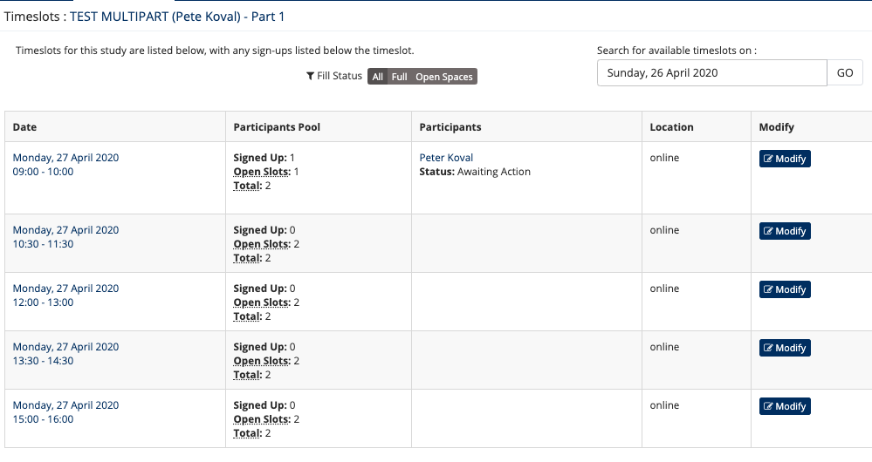
Example time-slots for two-part study
I’ve created 5 time-slots for PART 1 on a Monday
with a max. of 2 participants per time-slot.
**Alternatively, you could create 1 time-slot with max. 10 participants – it’s up to you**
When participants sign up for a time-slot, you’ll get their name and email, which you can use to send them a survey link and/or instructions for each part of your study.
Alternatively, you can include the survey link directly in SONA systems during study setup
One participant has signed up
For the first time-slot of PART 1

Slide 22
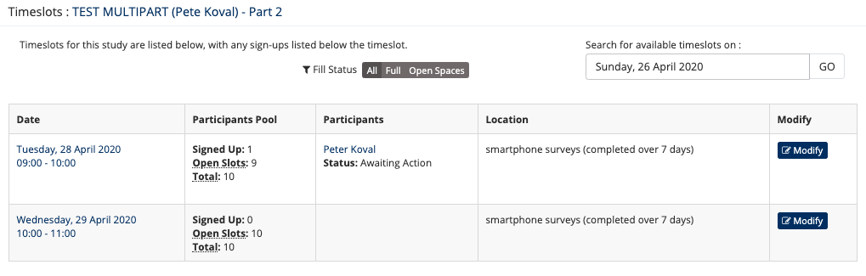
Example time-slots for two-part study
Here we have 2 time-slots for PART 2 on a Tuesday and Wednesday
with a max. of 10 participants per time-slot.
Participants will only be able to sign up to PART 2 if they’ve also signed up to PART 1.
One participant has signed up
For the first time-slot of PART 2

Slide 23
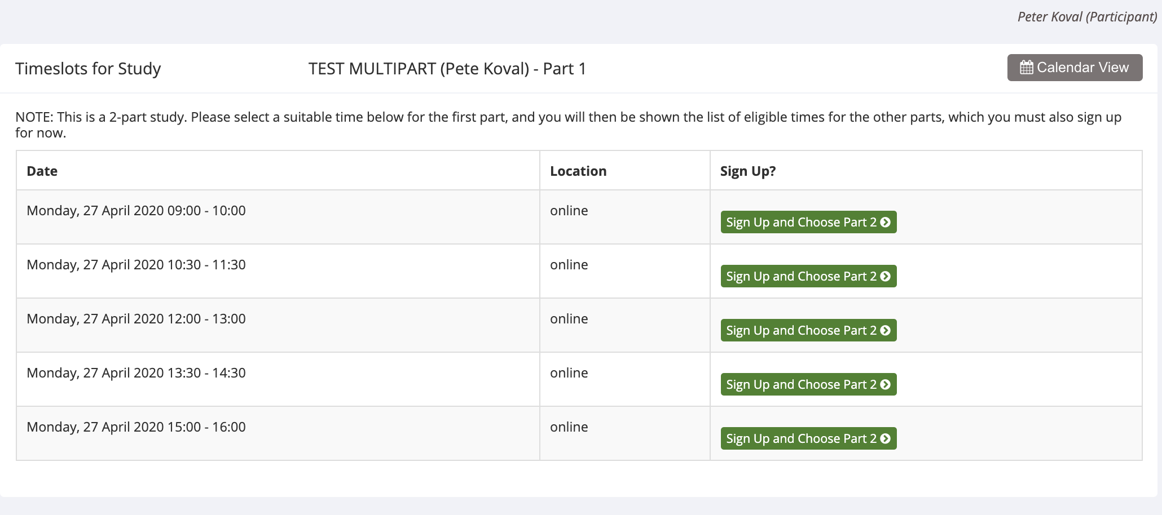
Example time-slots for two-part study – PARTICIPANT VIEW
Here’s what the participant will see when signing up to your study – PART 1

Slide 24
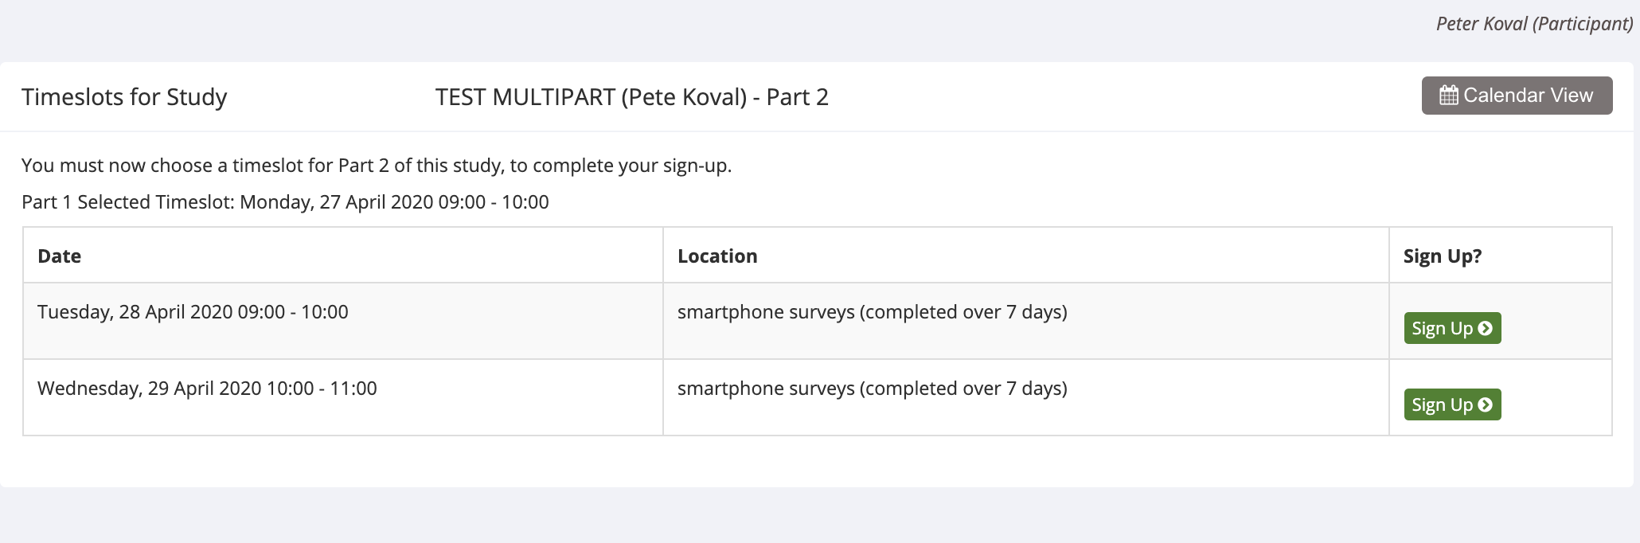
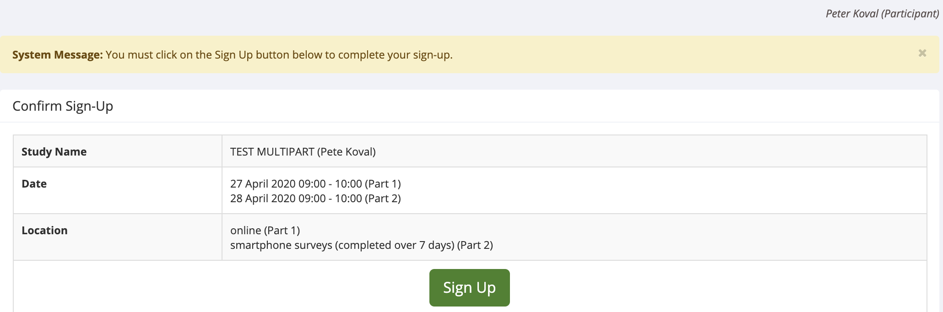
Example time-slots for two-part study – PARTICIPANT VIEW
Here’s what the participant will see when signing up to your study – PART 2
After selecting time-slots for PART 1 and PART 2, participant must confirm their sign up:

Slide 25
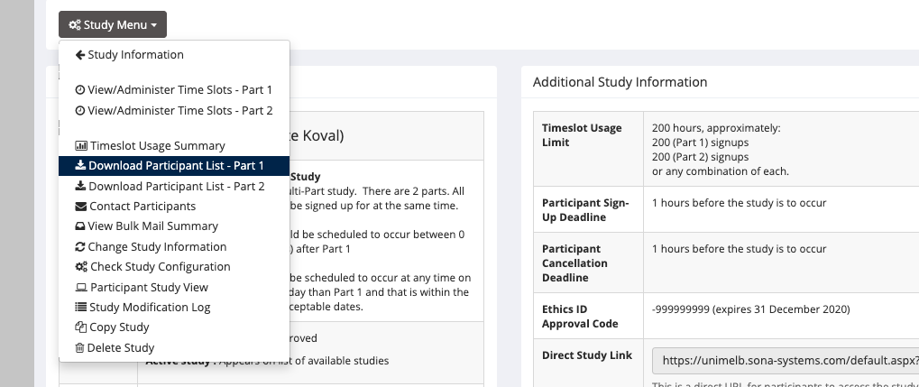
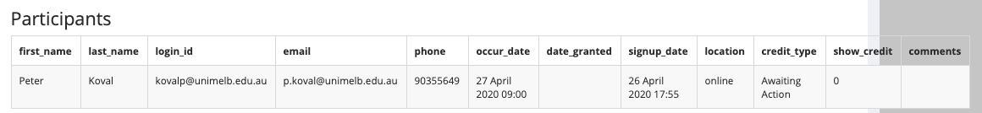
Example time-slots for two-part study
You can view who has signed up to your study by clicking on “Study Menu” and “Download Participant List- Part 1”
If you select “On-screen” output you’ll see the list of participants signed up to PART 1.
** alternatively, you can download the participant list as a .csv file**

Slide 26
NEXT STEPS:
GOOD LUCK WITH DATA COLLECTION!
Don’t forget:
Keep a close eye on SONA systems and other data collection platforms regularly for new sign-ups and study completions
communicate promptly and politely with participants
assign REP credits quickly (< 48 hours)
give participants the benefit of the doubt
check your data carefully for quality

