Slide 1

Fourth Year Psychology
Dr. Khandis Blake
(Fourth Year Program Convenor)
1

Slide 2

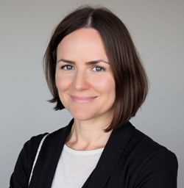
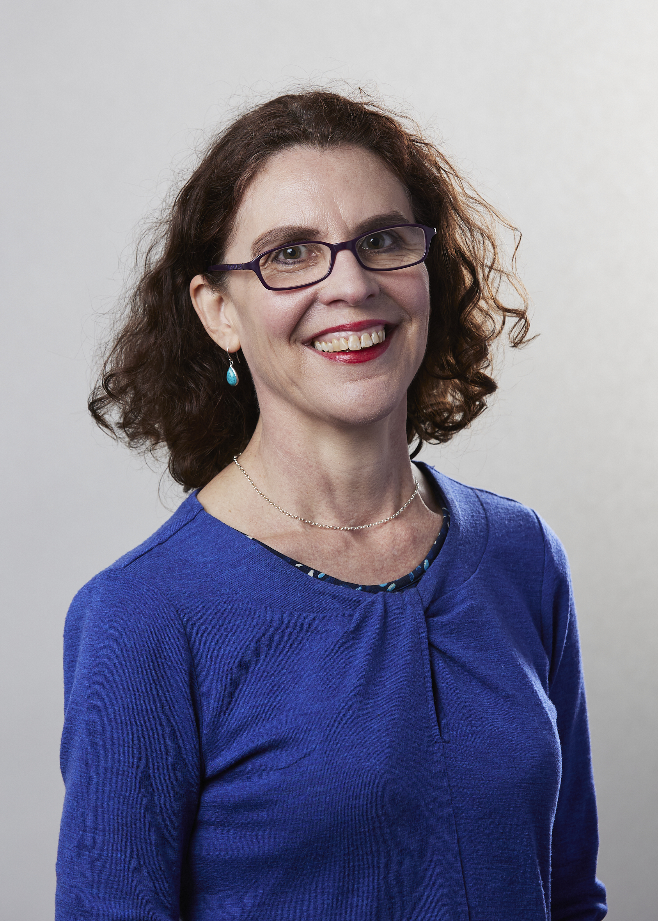
Key People
Fourth Year Convenor Oversees the fourth year program | Dr Khandis Blake
Fourth Year Deputy Convenor Supports fourth year oversight, runs pastoral care workshops and mini-conference | Dr Benita Green
Fourth Year Academic Programs Officer Supports administration of the program, manages the fourth year inbox | Judy Vo

Slide 3
Other Key People
Your fellow classmates!
Let’s start getting to know each other.
Everyone stand up!
You need to meet 10 different people.

Slide 4
For each person, find one item from this list
Honours-Themed
… chose honours for a specific career goal
… chose honours because they loved one subject
… is thinking about a PhD
… is definitely not thinking about a PhD
… has already changed their research idea once
… is excited about statistics
… is nervous about statistics
… has worked with their supervisor before
Motivation & Personality
… does their best work under pressure
… does their best work when they plan ahead
… is more qualitative than quantitative (or vice versa)
… loves group work
… prefers working independently
… procrastinates but still gets things done
… has a colour-coded calendar
Relatable
… has had a major plan change in the last two years
… is the first in their family to do honours
… works part-time while studying
… commutes more than 45 minutes
… has already bought new stationery for honours
… has a study ritual (music, café, late nights, etc.)
Connection
… is doing honours to challenge themselves
… wants this year to be different from previous years
… is excited but slightly terrified
… hopes to build close friendships this year
… wants to improve one specific skill
Notes:
After 10 minutes:
“Who met someone with the opposite study style to them?”
“Who found someone who’s thinking about a PhD?”
“Who met someone with the same research interest?”
“Who met someone who was excited by slightly terrified?”

Slide 5

Key Information
Everything you need to know is in the Fourth Year Manual. The most updated version of the manual is on LMS: https://canvas.lms.unimelb.edu.au/
If you really, truly cannot find the answer in the Fourth Year Manual, email the fourth year inbox: fourthyear-psych@unimelb.edu.au
You might also find an answer here:
        Student Portal: www.my.unimelb.edu.au
        Stop 1: http://students.unimelb.edu.au/stop1
        MSPS website: www.psych.unimelb.edu.au

Slide 6
Key Information
What is Stop 1?
Admissions information: getting information on prospective
courses and entry requirements
Administrative services: student cards, fees, transcripts, graduation
Enrolment services: course planning, enrolment assistance,
special consideration, student equity
Support services: Disability; housing; financial aid, elite athletes and safety on campus
Skills and development services: careers; academic skills;
student connect; study abroad and exchange.

Slide 7



Seeking answers
Problem solved
Problem solved
Consult LMS site for that subject
Problem not solved
Contact subject convenor
A specific subject
What does the issue concern?
My research project
Contact your supervisor
Problem not solved
Something else
Problem not solved
Contact the 4th year inbox
I have a question / need help
Consult the 4th year manual
Khandis or Judy will respond, refer your issue on to someone else, or schedule meeting if necessary
Problem solved

Slide 8
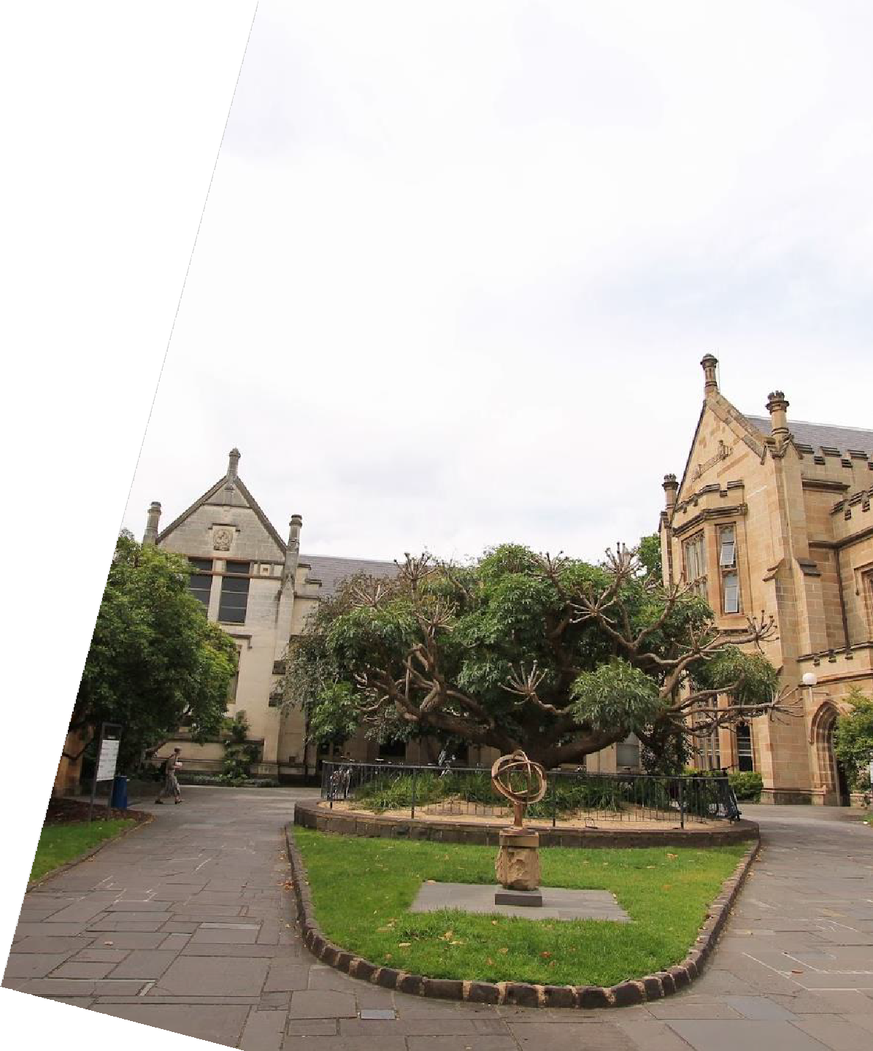
Any questions so far?
17

Slide 9

The Program
A transitional year on the way to becoming an
independent researcher and/or practitioner
A research apprenticeship
  Semi-autonomous research project
  1-on-1 collaboration with a research academic
Advanced coursework & electives
  Builds foundational competencies in psychology
  Feeds into research training
  Also introduces some pre-professional skills

Slide 10

The Program
Supervised research project
  50 credit points
  Whole year subject
Two core subjects
  Total of 25 credit points
  Semester 1
Two advanced elective subjects
  Total of 25 credit points
  Semester 2

Slide 11
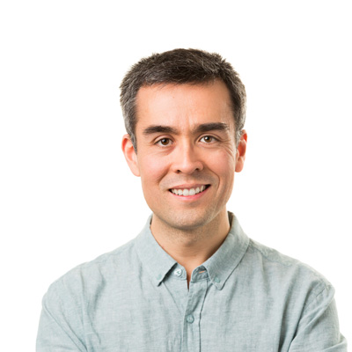
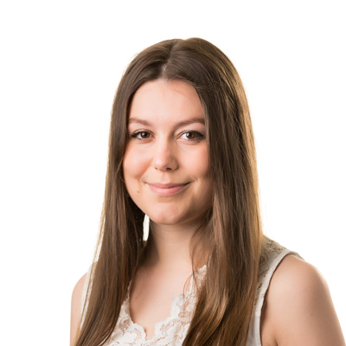
Core Subjects – first semester
Advanced Design & Data Analysis (ADDA)
  PSYC40005
  Multivariate statistics and data analysis
  Convenor: Dr. Geoff Saw and Andrew Legg (co-convenors)
Ethics and Evidence-Based Practice
  PSYC40006
  Code of ethics, scientist-practitioner framework,
  Pre-professional applied skills (e.g., assessment &
evaluation)
  Convenor: Dr Vanja Rozenblat

Slide 12
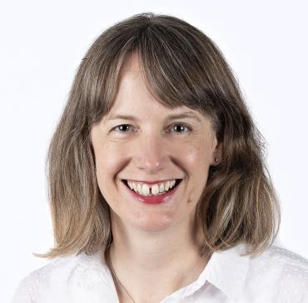
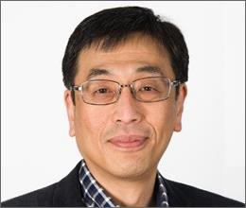
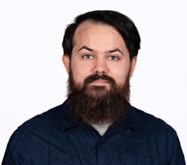
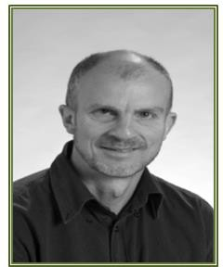
Elective Subjects – second semester
Current Topics in Developmental Psychology
PSYC40001; Convenor: Prof. Katherine Johnson
Current Topics in Social Psychology
PSYC40002; Convenor: Prof. Yoshi Kashima
Behavioural and Cognitive Neuroscience
PSYC40004; Convenor: Dr. Dr Daniel Feuerriegel
Models of Psychological Processes
PSYC40012; Convenor: Prof. Philip Smith

Slide 13

The Research Project PSYC40010
No two projects alike
Different supervisory styles. Look at the minimum standards for supervision in the fourth year manual for more.
No project is ‘better’ for clinical (or any other) pathway

Slide 14
Any questions so far?
17

Slide 15
Alumna Talk

Slide 16
Responsibilities of Honours Researchers
Honours researchers are expected to engage actively and responsibly in their research training.
It is imperative that you read this section in the fourth year manual.
It discusses what we expect of you, how to communicate with the university, expected codes of conduct, and how to resolve issues.
One thing it mentions explicitly – the expected time per week to spend on your research project is 20 hours.

Slide 17
Switching to Part-Time Enrolment
If you wish to switch to part-time enrolment, you may do so. This requires postponing your coursework subjects while continuing with your thesis.
  We recommend completing the Semester 1 compulsory subjects—PSYC40005 (Advanced Design and Data Analysis) and PSYC40006 (Ethics and Evidence-Based Practice)—concurrently with the thesis.
  If you decide to transition to part-time enrolment anyway, we strongly advise that you consult with your research project supervisor before making any changes.
  This consultation will allow you to discuss potential academic implications of the enrolment change and identify strategies to minimise any adverse impact of completing the thesis prior to these compulsory subjects.
All requests to switch from part-time to full-time enrolment, which would normally involve a late enrolment in PSYC40010 (Research Project), are subject to supervisor availability at the time the request is made.

Slide 18
Assessments
Draft Introduction with maximum word length of 3,000 words (hurdle requirement). Due on Thursday June 25th 2026 before 1159pm.
10-minute oral presentation of research project (hurdle requirement) to be given during the fourth year Mini Conference. The conference will be held on Monday, 28th September 2026 between 9am – 5pm.
Empirical Report with a maximum word length of 9,000 words, incorporating a revision of the Draft Introduction (100% weighting). Due on Thursday October 22nd 2026 before 1159pm.
All assessment tasks listed above must be completed to enable a passing grade for this subject.
Be mindful of the impact of extensions
Notes:
Mini conference is very important

Slide 19

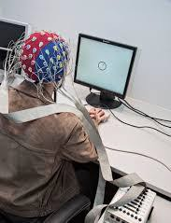

The Research Project
Projects vary a lot: some have single versus multi-supervisor teams; some use new versus existing data; some projects are joint some are individual.
  Commonalities: 20 hours per week
What makes for a top thesis? Fulfilling the requirements as outlined in the Fourth Year Manual

Slide 20
Any questions so far?
17

Slide 21
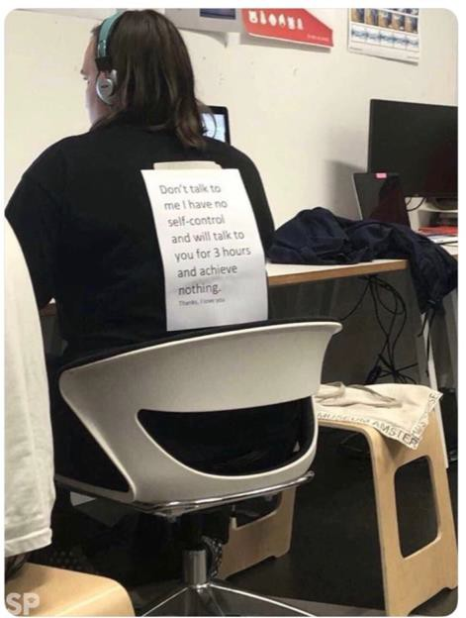
Working with your supervisor
Determine when to meet, and how often
Create a yearly plan first up, and get their approval
Make it yours. Showing up isn’t enough!
Discuss with your supervisor:
      Ethical approval? (You can’t collect data without it)
      Data collection? (What’s involved?)
      Analyses (What might these look like?)
      Absences (Are you or your supervisor away at any point during the year?)
      Readings (Any references to get you started?)

Slide 22

Wellbeing
Fourth year can be a stressful process
If you want to be a clinician, start investing in learning about resilience and handling stress now
Ignore the ‘rumour mill’
Make a schedule/workplan
Your supervisor is your mentor and advisor – ask
for their advice. If you need advice outside of your supervisor, talk with Khandis or Benita. If things get bad, contact us and/or Student
Services (see the Fourth Year Manual)
Keep balanced - It’s a marathon not a sprint

Slide 23
Attend Honours Workshops!!
We’re running two optional workshops to support wellbeing and effectiveness
      Workshop 1: Thursday 12th March, 2-4pm. Location TBC.
      Managing stress and staying productive
      Developing an effective working relationship with your supervisor
      Workshop 2: Early in semester 2
      Preparing for the mini conference
      Writing, drafting, & responding effectively to supervisor feedback
Benita will be running the optional workshops in person.
Details will be advised through Canvas announcements.

Slide 24
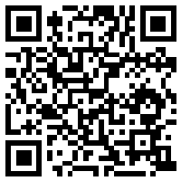
Stay Connected
Check announcements (LMS, your University of Melbourne email)
Attend lectures unless absolutely impossible
Regular supervision meetings - your supervisor is your mentor and advisor…
If you have a lab group/team, get involved
Go to talks, seminars, events
Connect with GRiPS
Form study groups
JOIN THE
HONOURS 2026 (UNOFFICIAL) PLAYLIST
https://go.unimelb.edu.au/x8j2

Slide 25
ACTIVITY: Stand in the Future, Looking Back
We’re going to do this activity now (on paper, like its 1990)
Imagine it is mid December 2026. You’ve completed your thesis, you’ve finished your subjects, and you’ve just received your honours grade. It was a big year – but you did it!
Write a letter to yourself (now), from this future self. In your letter, you might reflect on:
  What you’re most proud of
  What you found hardest (and how you got through it)
  What you learned about yourself this year
  Advice you’d give your past self
  What you hope comes next
Be honest with yourself – this is just for you. We will collect these letters at the end of this orientation and give them back to you at our End of Year Celebration Event.

Slide 26
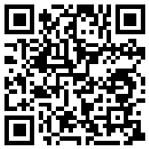


LET’S CONNECT NOW!
Unsure? Go here and look at each hub’s “people” to find your supervisor
https://go.unimelb.edu.au/huw8
Time to get into your research groups and meet your colleagues.
Notes:
EWB – anything to do with morality, personality, childlessness, emotion, culture, reporting errors, replication, wellbeing – probably in here
CHDH – language, information processing, social networks – probably in here
Cog Neuro – brain, learning, memory, attention, imagination, decision-making
Contemplative studies – meditation
Brain and mental health – clinical, disorder, addiction, performance anxiety, Orygen, – here
MCBC – behavior change, interventions, tobacco use, cancer – probably here

Slide 27
Come see us if you have any remaining questions ☺
Don’t forget to give us your letters before you leave!
17

