Slide 1



MELBOURNE UNIVERSITY
P
SYCHOLOGY
SSOCIATION
A

Slide 2




600+ MEMBERS
30+ SUBCOMMITTEE MEMBERS
CHARTING OUR
20+ EVENTS PER YEAR
g
ROWTH
3000+ FOLLOWERS ON INSTAGRAM
AFFILIATED WITH UMSU, MSPS & MDHS

Slide 3

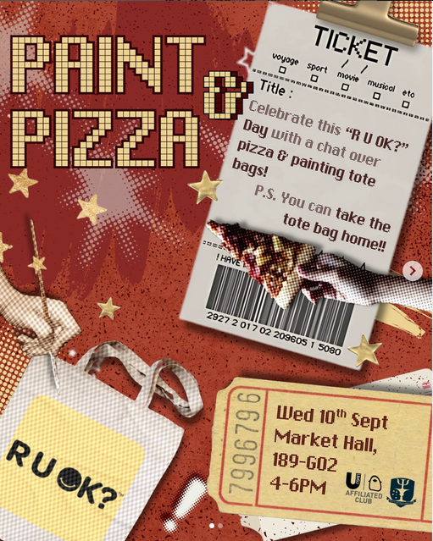



SOCIALS
SEMESTER ONE
SEMESTER TWO
To provide students of psychology and those interested in the field with social opportunities.

Slide 4





EDUCATION
SEMESTER ONE
SEMESTER TWO
To assist students through lectures and navigating potential job opportunities, volunteer work and other opportunities available to undergraduates in the field of psychology.

Slide 5
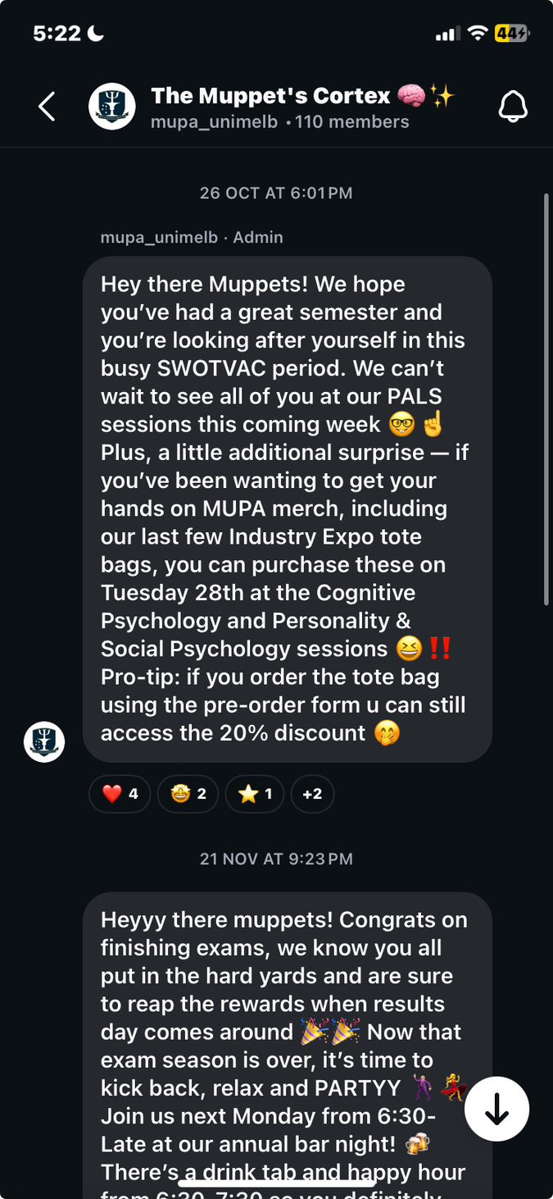

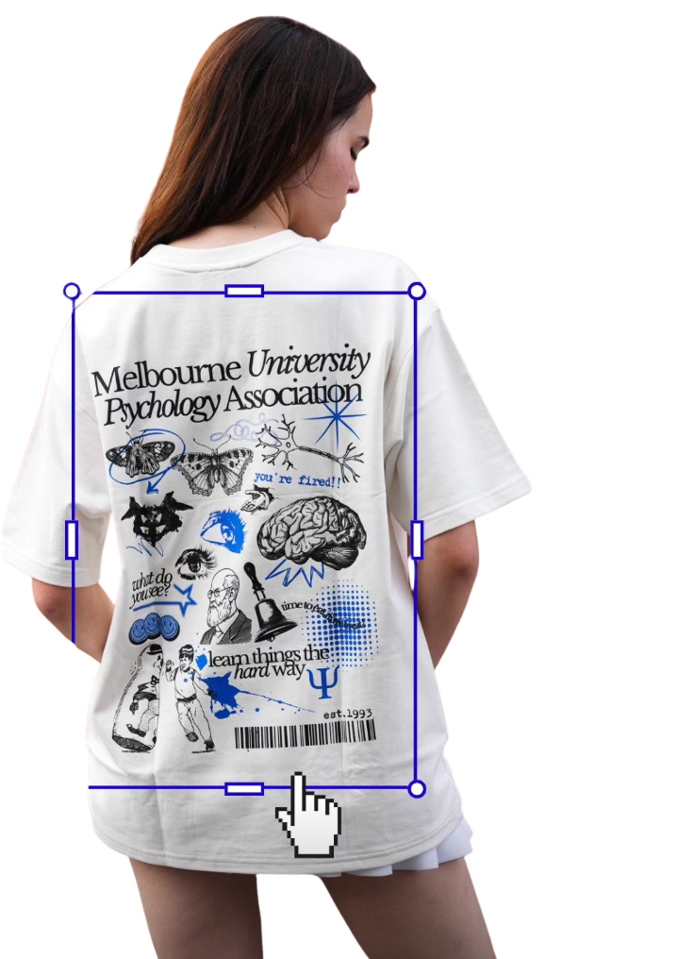
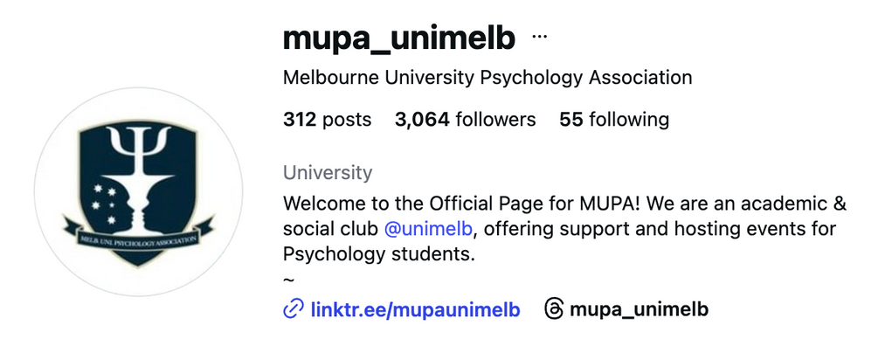
MEDIA
To build a network within the broader student community through communicative media and
merchandise design.

Slide 6











SPONSORSHIPS
To foster meaningful and signification external brand collaborations in pursuit of benefits for MUPA community.

Slide 7


WHAT ARE WE OFFERING TO HONOURS STUDENTS?
THESIS PEER REVIEW WORKSHOP
DATA CLEANING WORKSHOP
Both occurring end of Semester 1 / beginning of Semester 2

Slide 8



HOW DO I GET INVOLVED?
BECOME A MEMBER
ATTEND OUR EVENTS
BECOME A PALS LEADER

Slide 9
