Slide 1





Slide 2
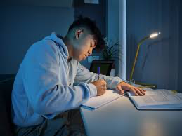

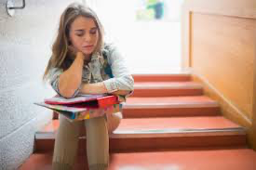
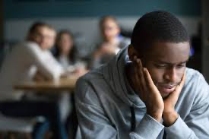
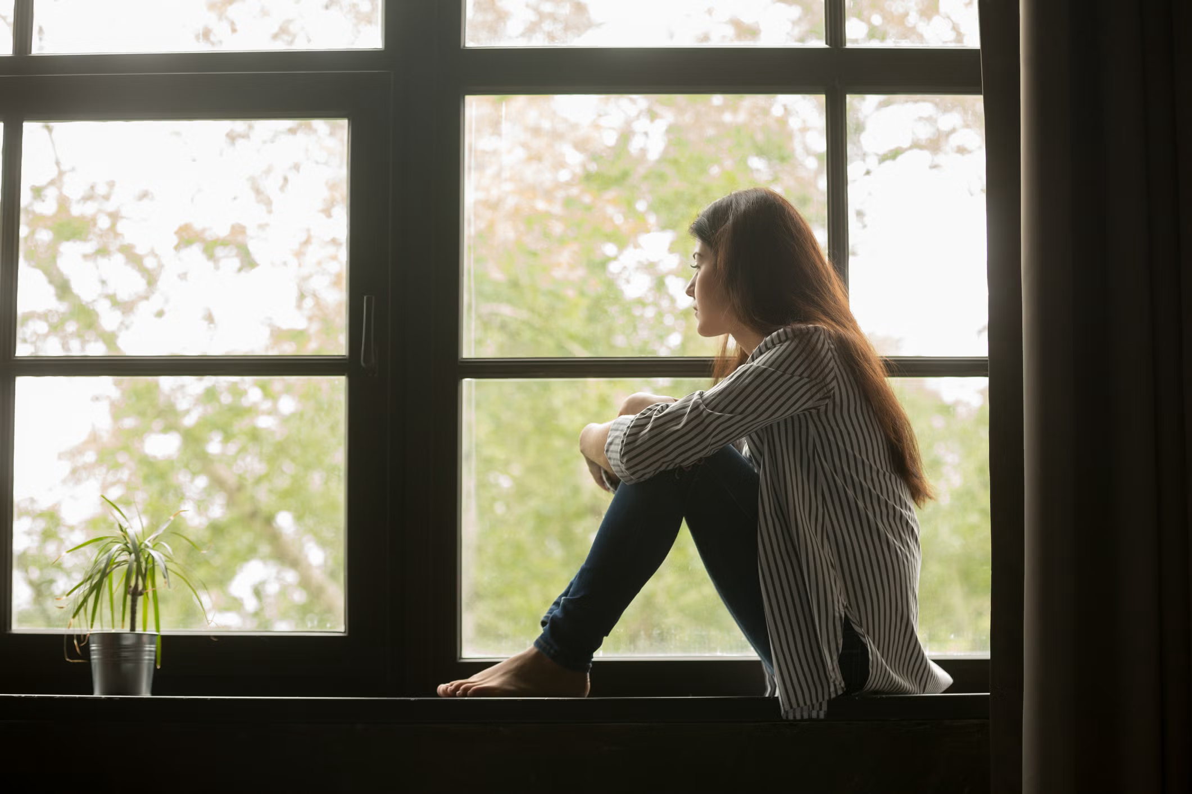
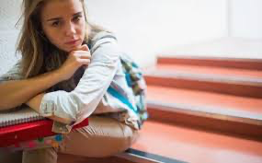

Slide 3
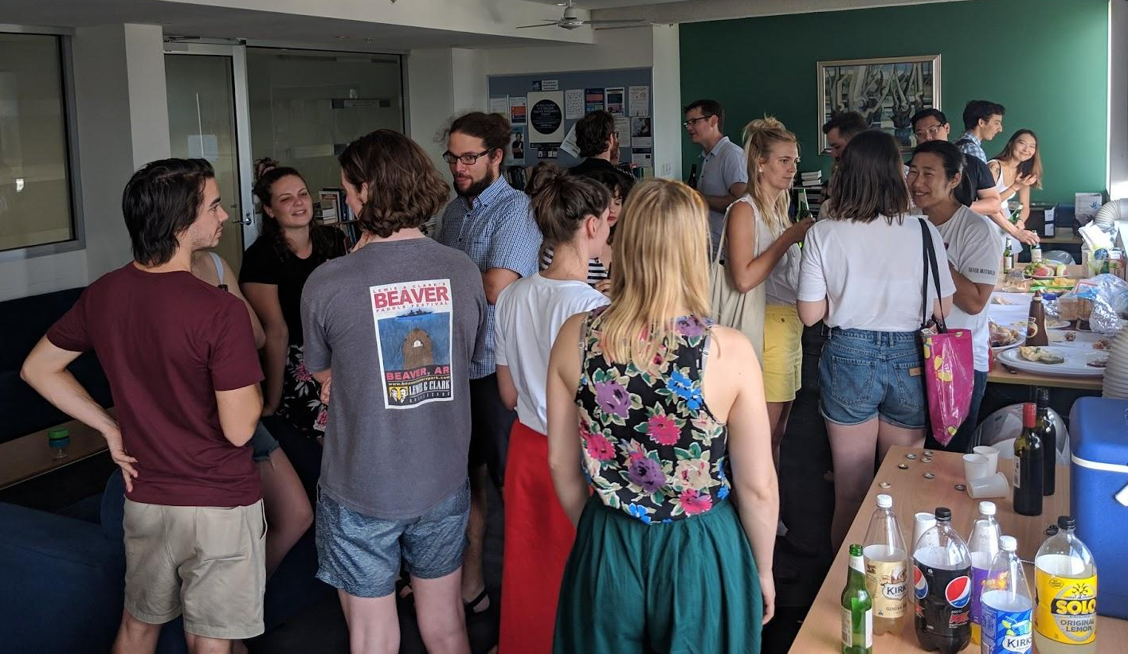
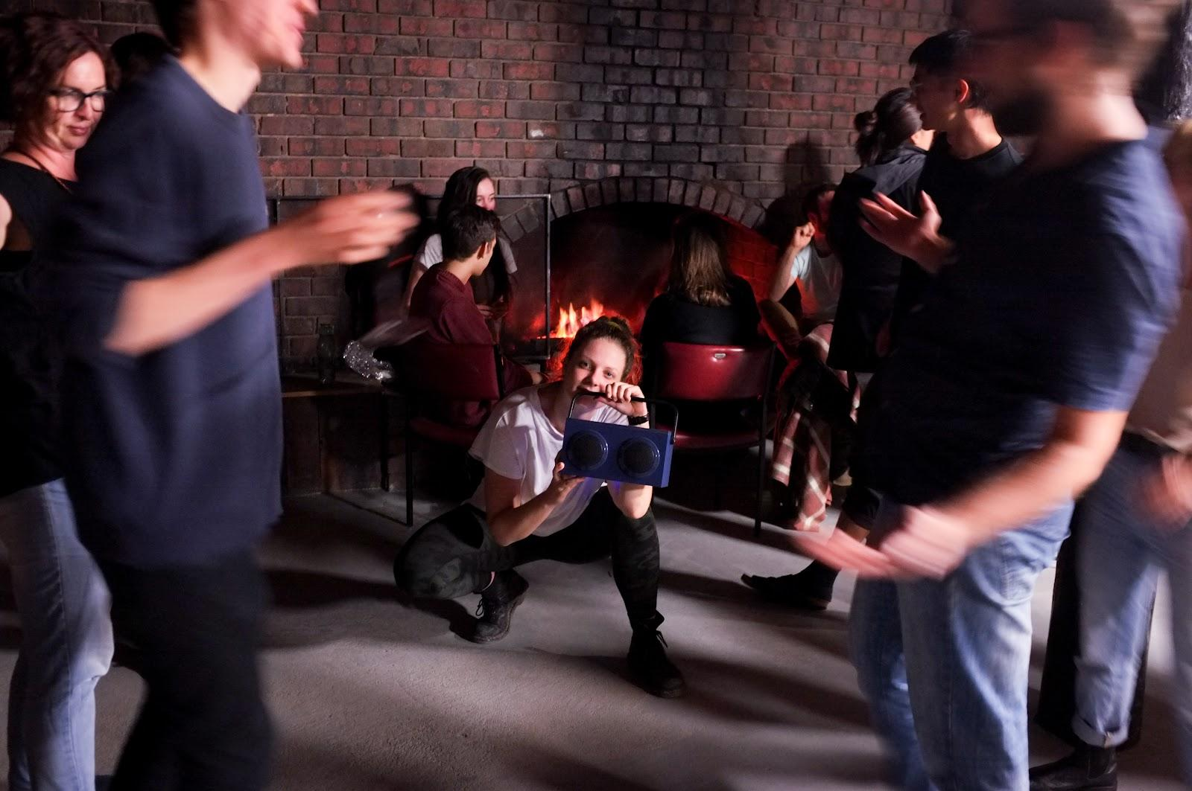
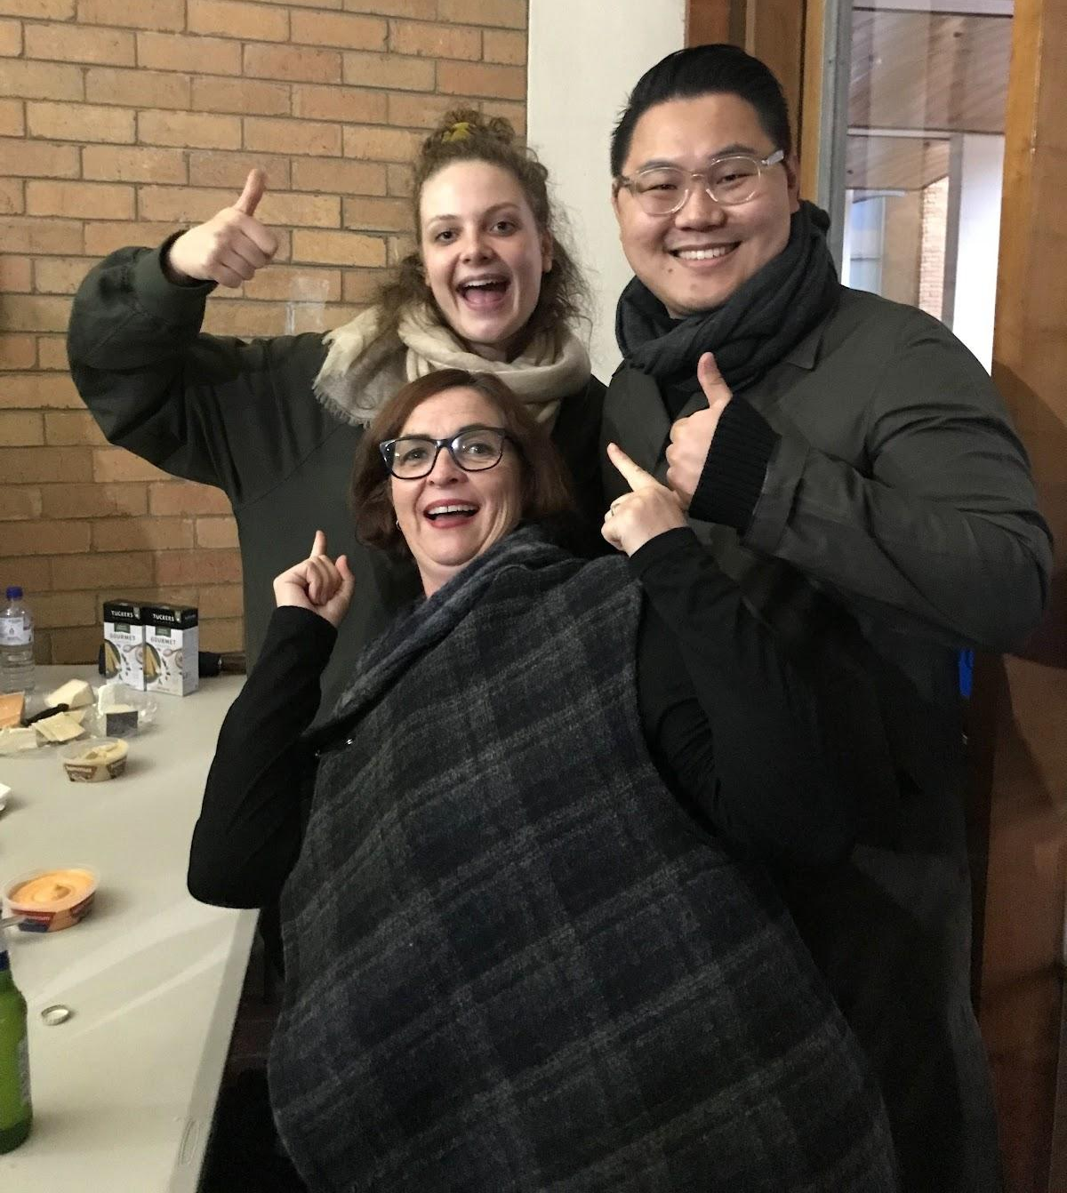
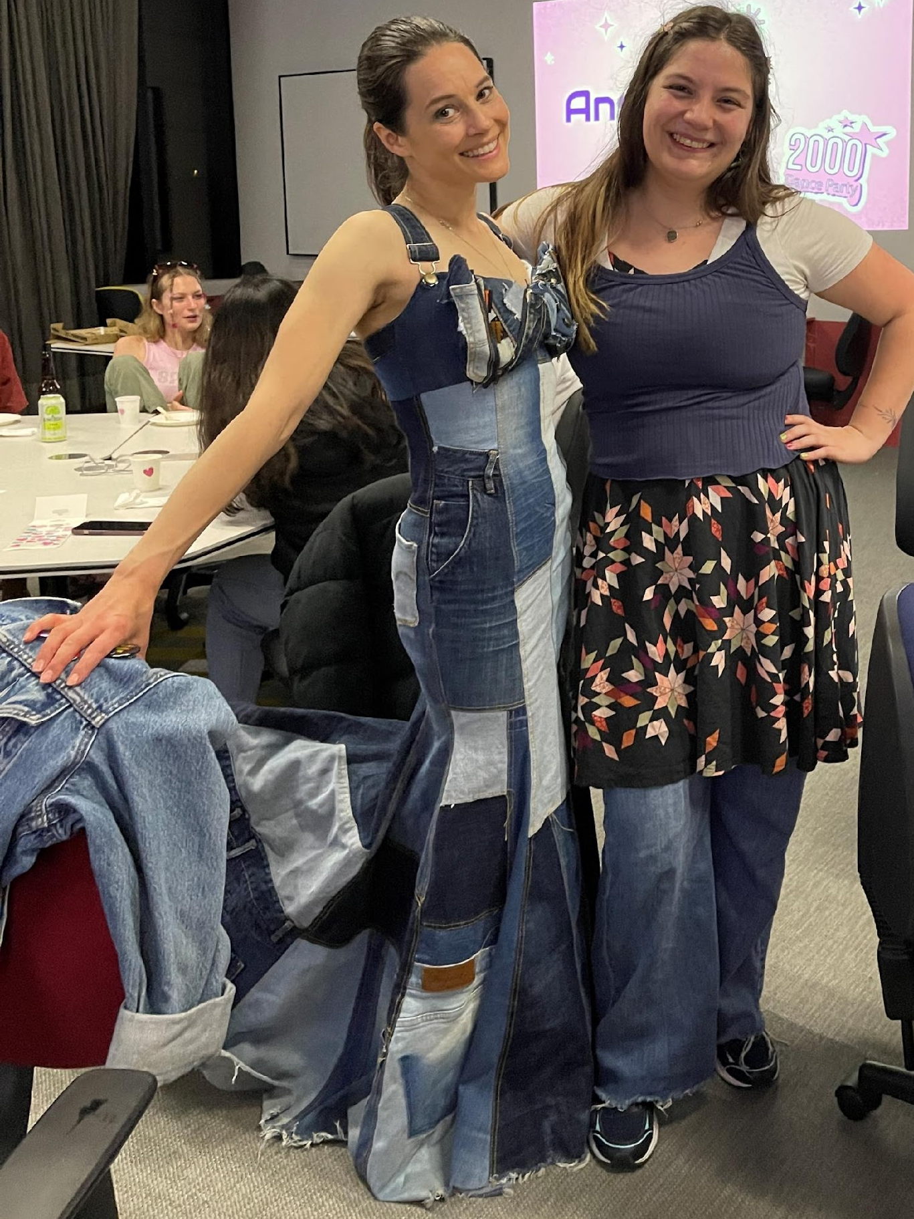
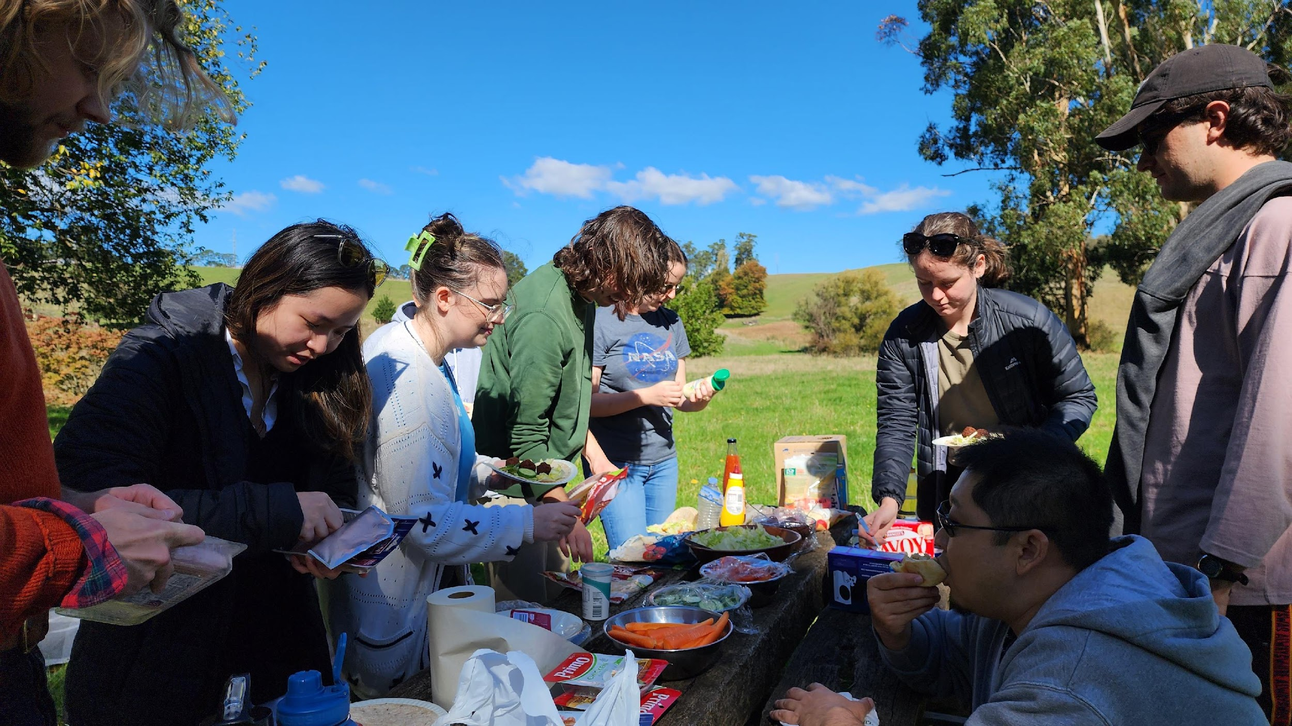
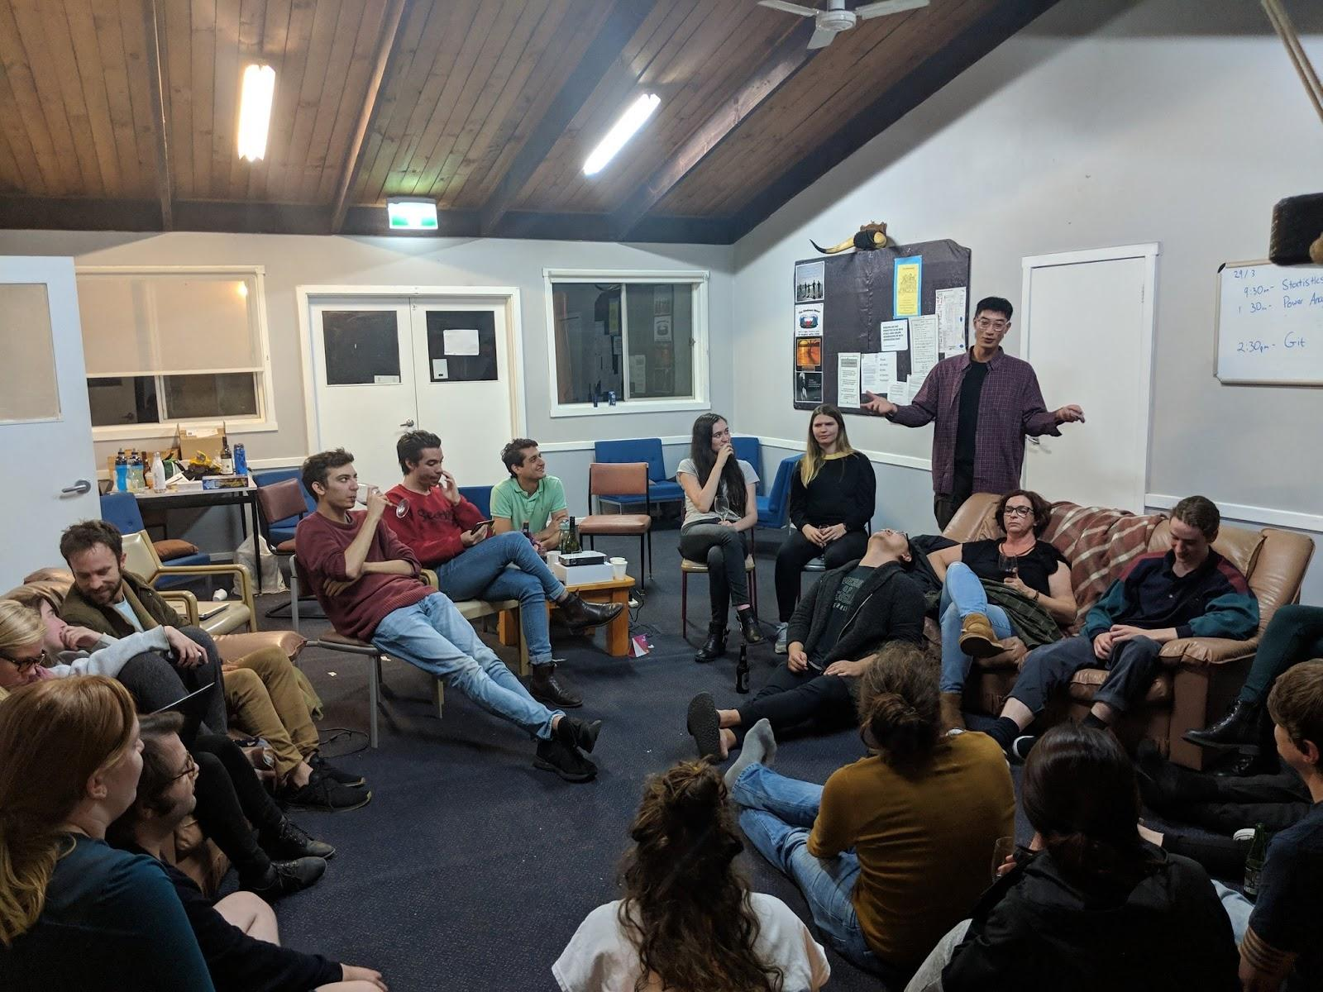
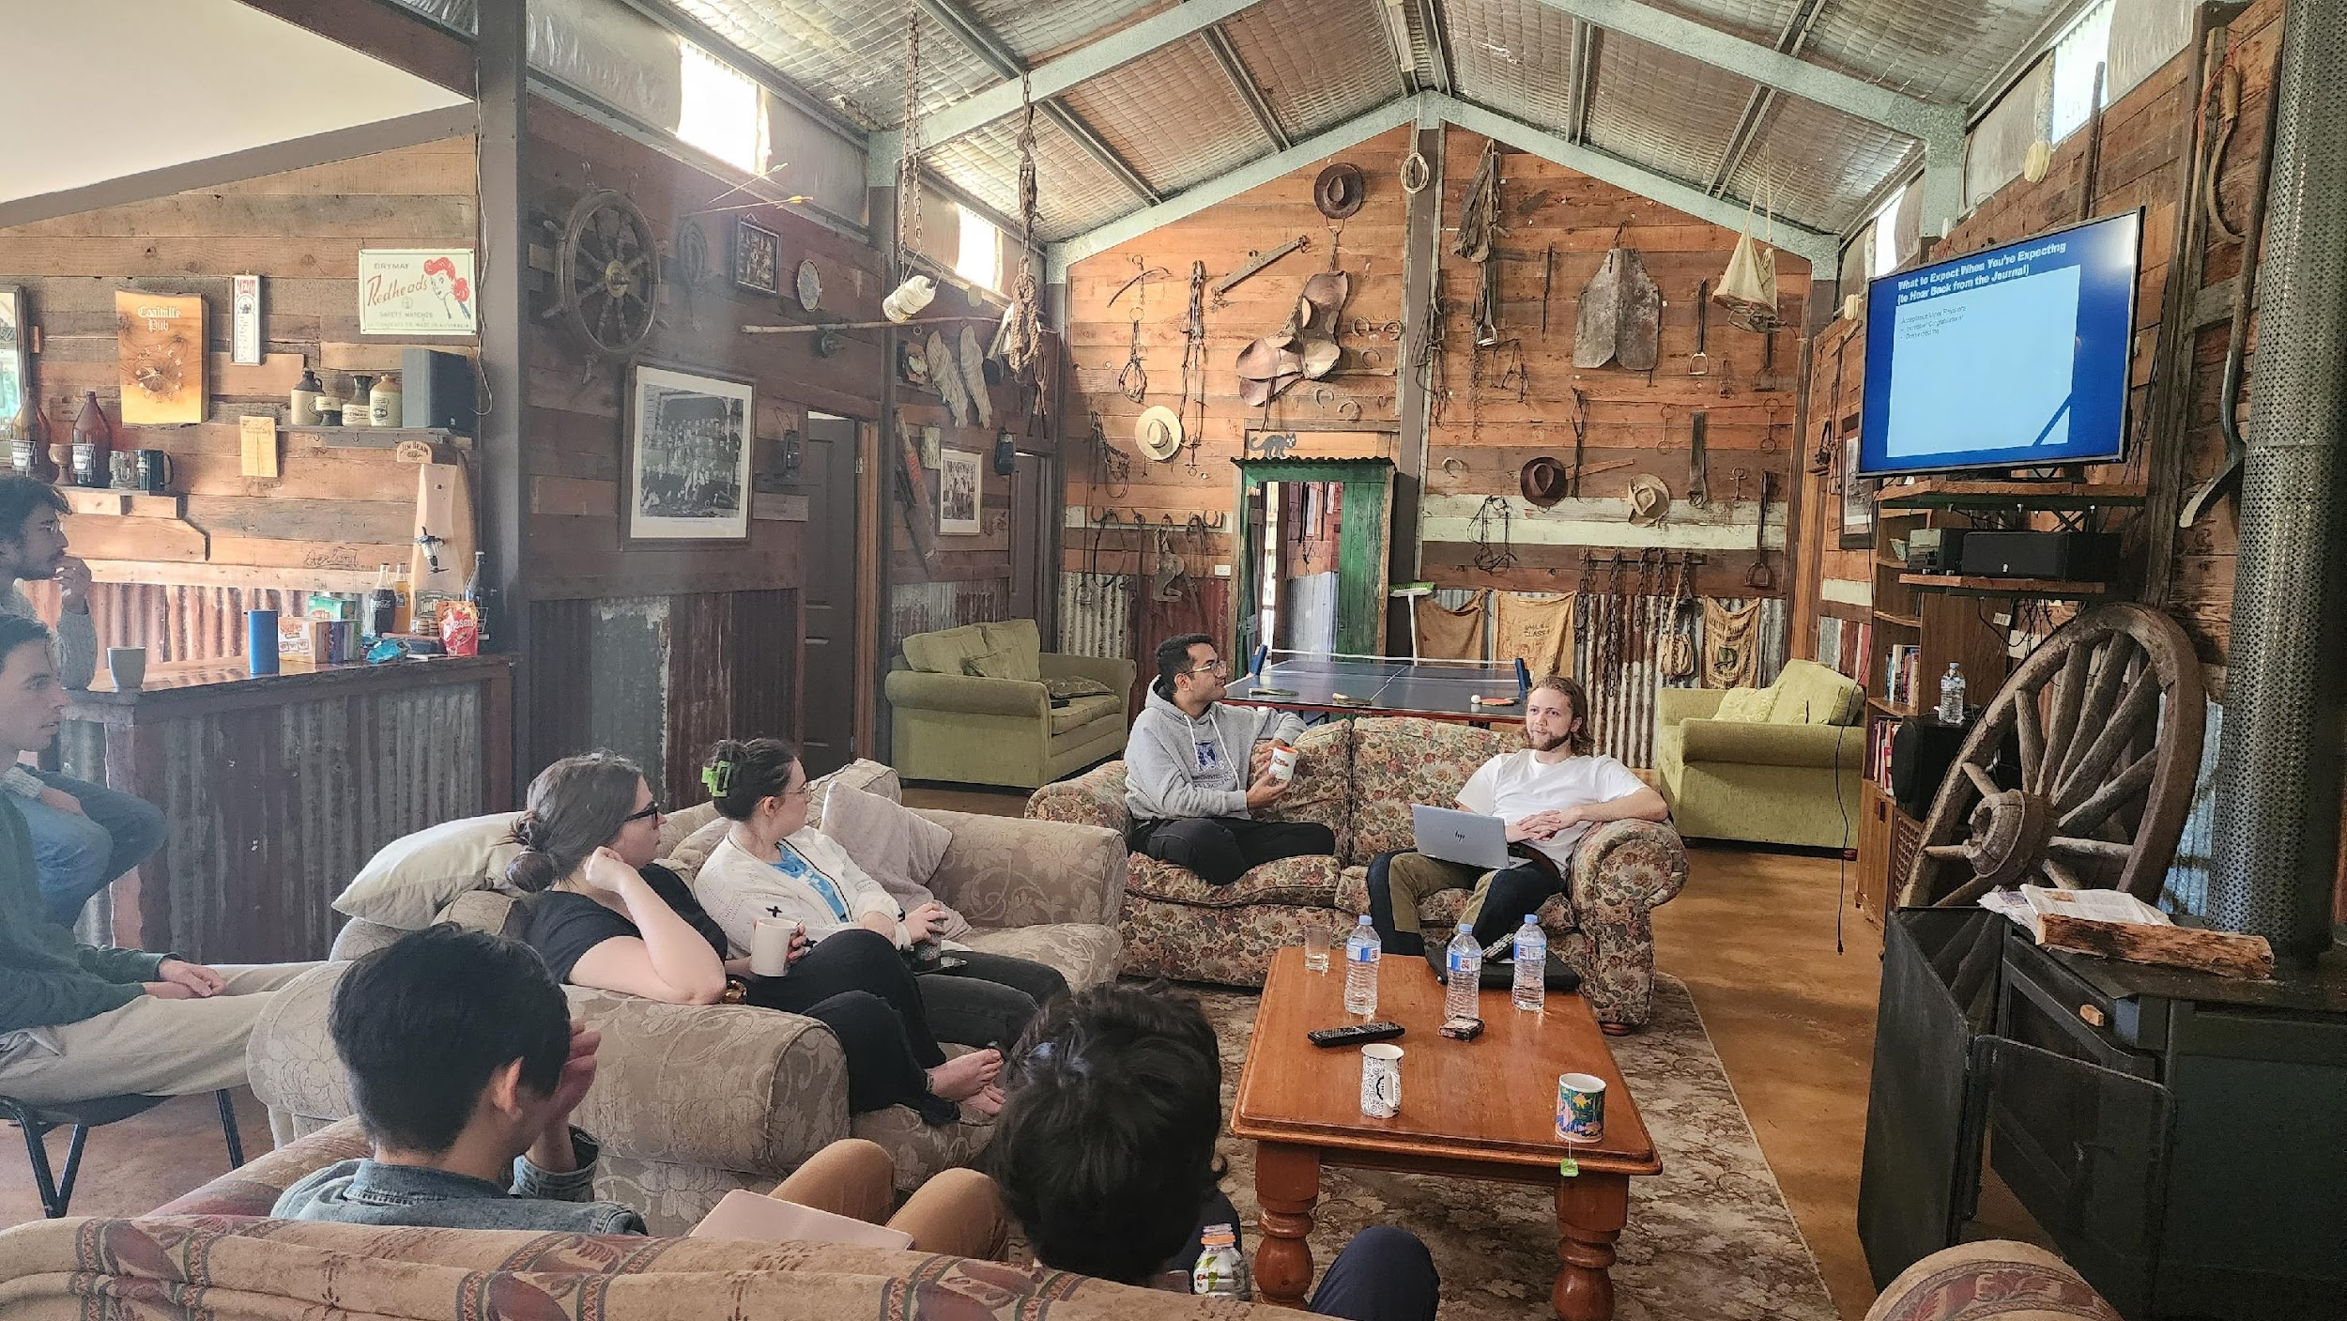
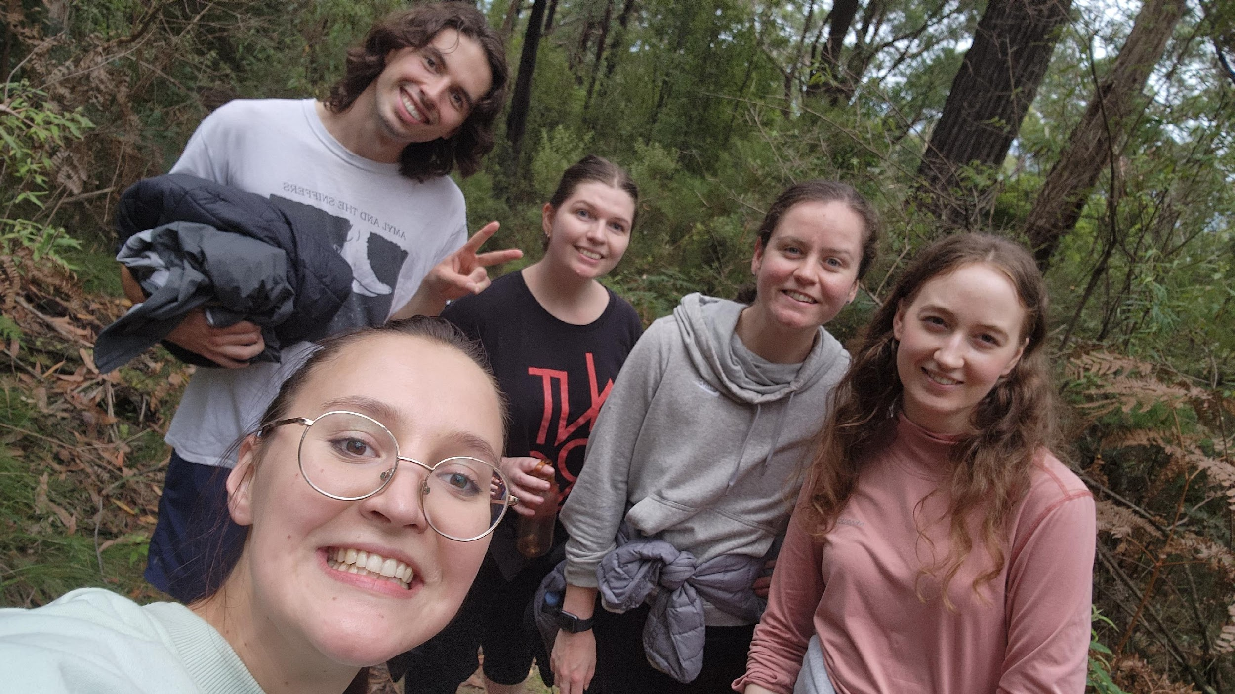
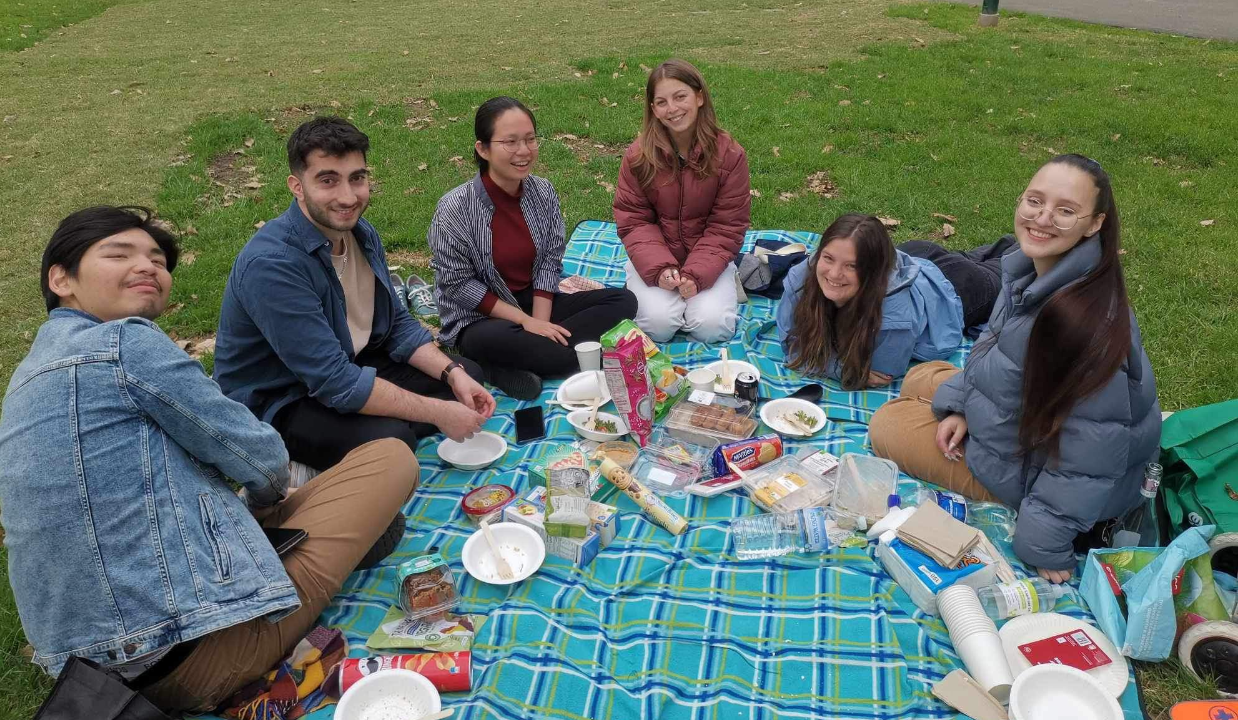
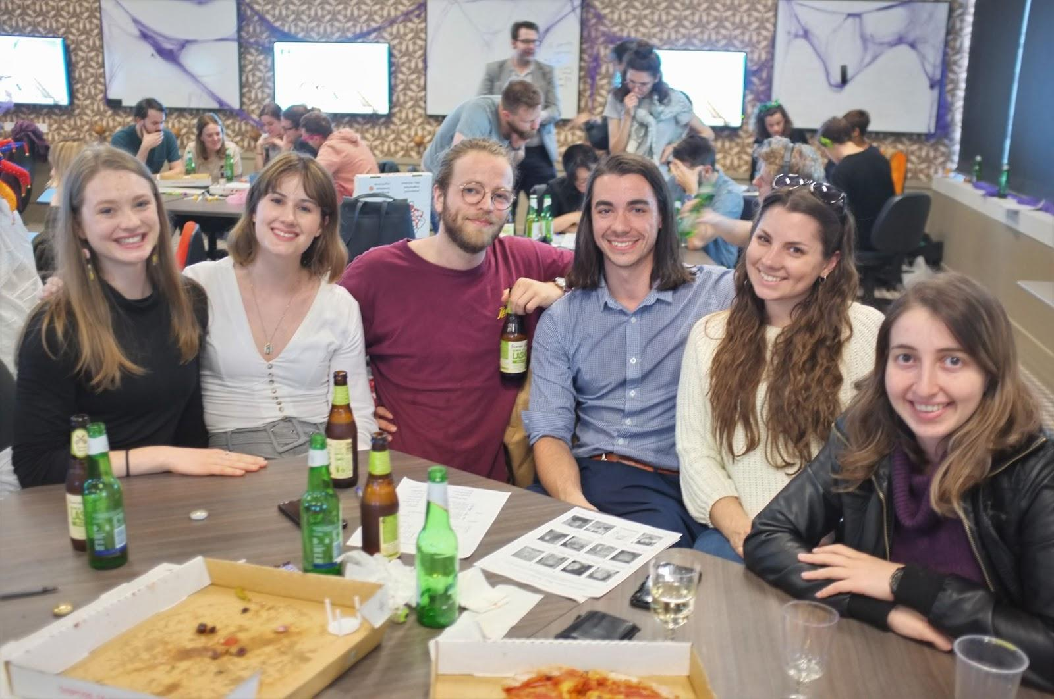
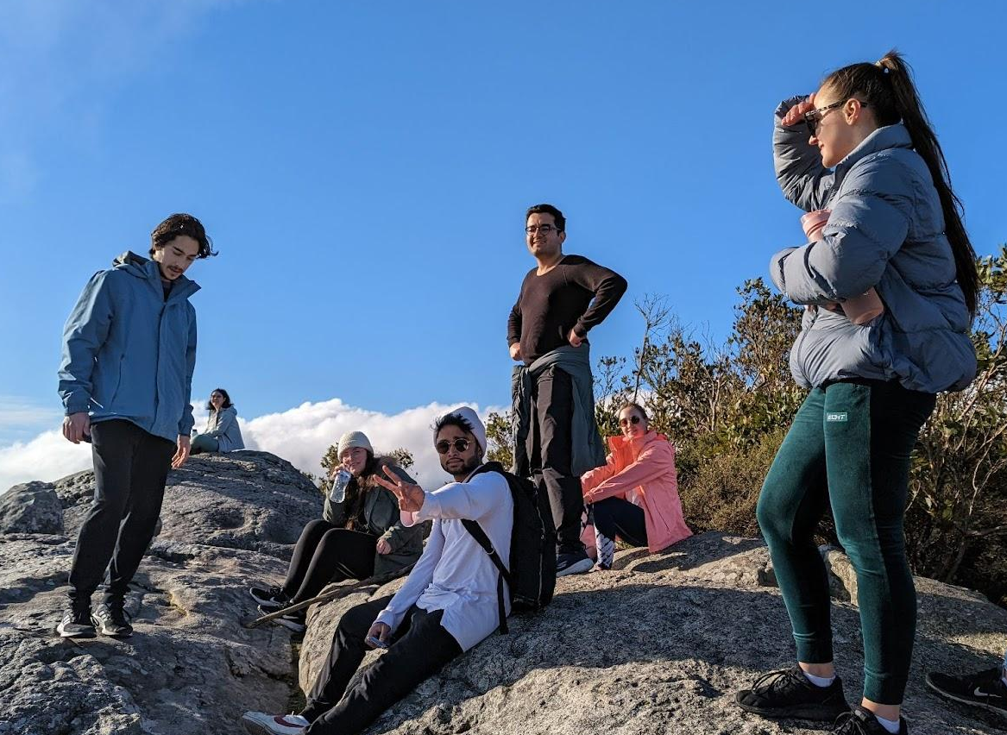
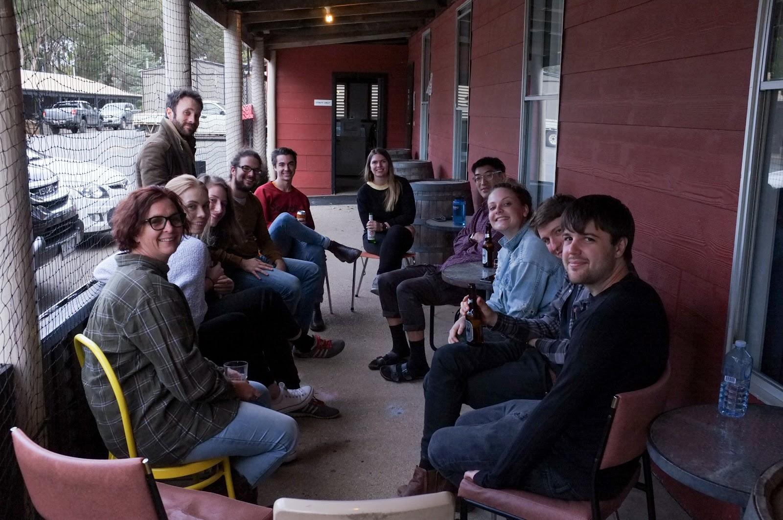
Who are we?
A student run organisation
Committed to providing social and academic support to:
  Honours
  Masters
  PhD students

Slide 4

Overview
MAJOR EVENTS
RECURRING ACTIVITIES:
🍹 Welcome drinks (2nd week of March)
⛺ GRIPS Camp (second half of 2025)
❓ Trivia night (semester 2)
✍️ Shut Up & Write (weekly)
📚 Book club (4x per year)
🧠 Workshops/skillshares
🎲 Board games, crafts, & movie night!
*SUBJECT TO CHANGE / OPEN TO SUGGESTIONS: IF YOU JOIN AND HAVE SOMETHING YOU WANT TO PROPOSE OR OFFER AS AN ACTIVITY, WE CAN HELP MAKE IT HAPPEN!

Slide 5

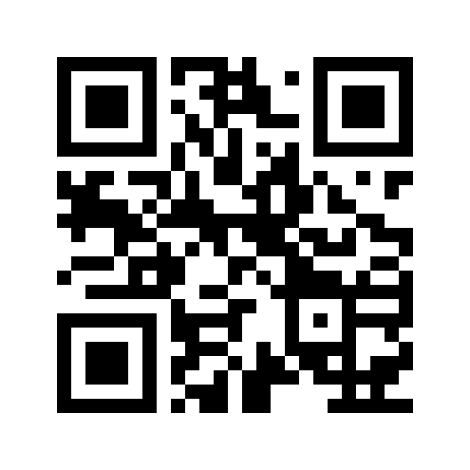
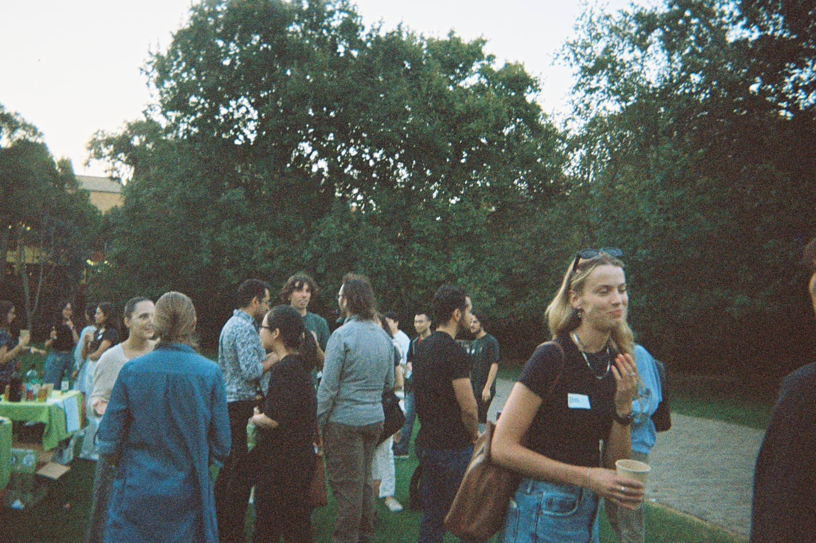
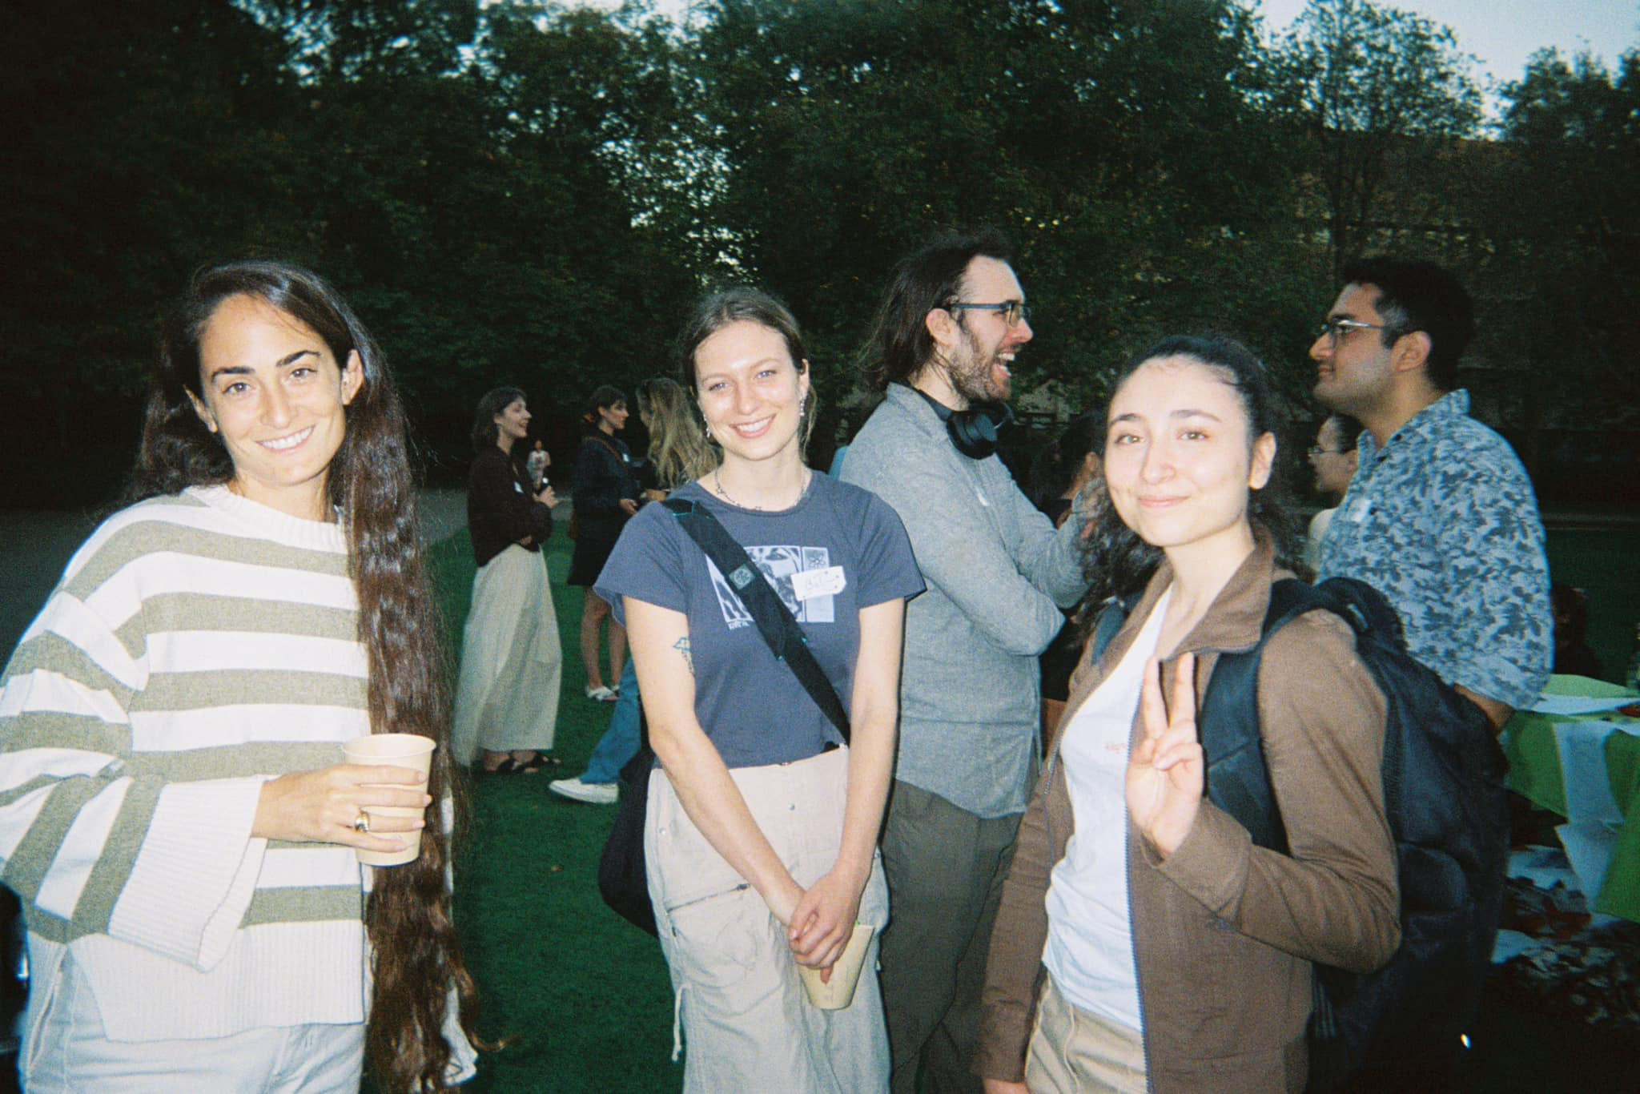
Welcome Drinks
Come & mingle with other psych graduate students!
Drinks and food provided
Date: Fri 13th March, 3:00pm
Location: South Lawn
Join GRiPS at http://eepurl.com/cyaAsz

Slide 6
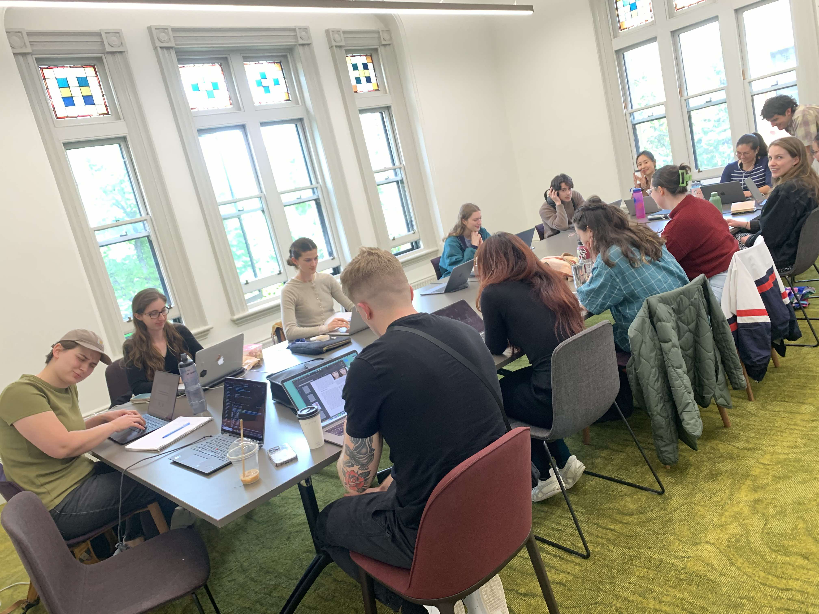
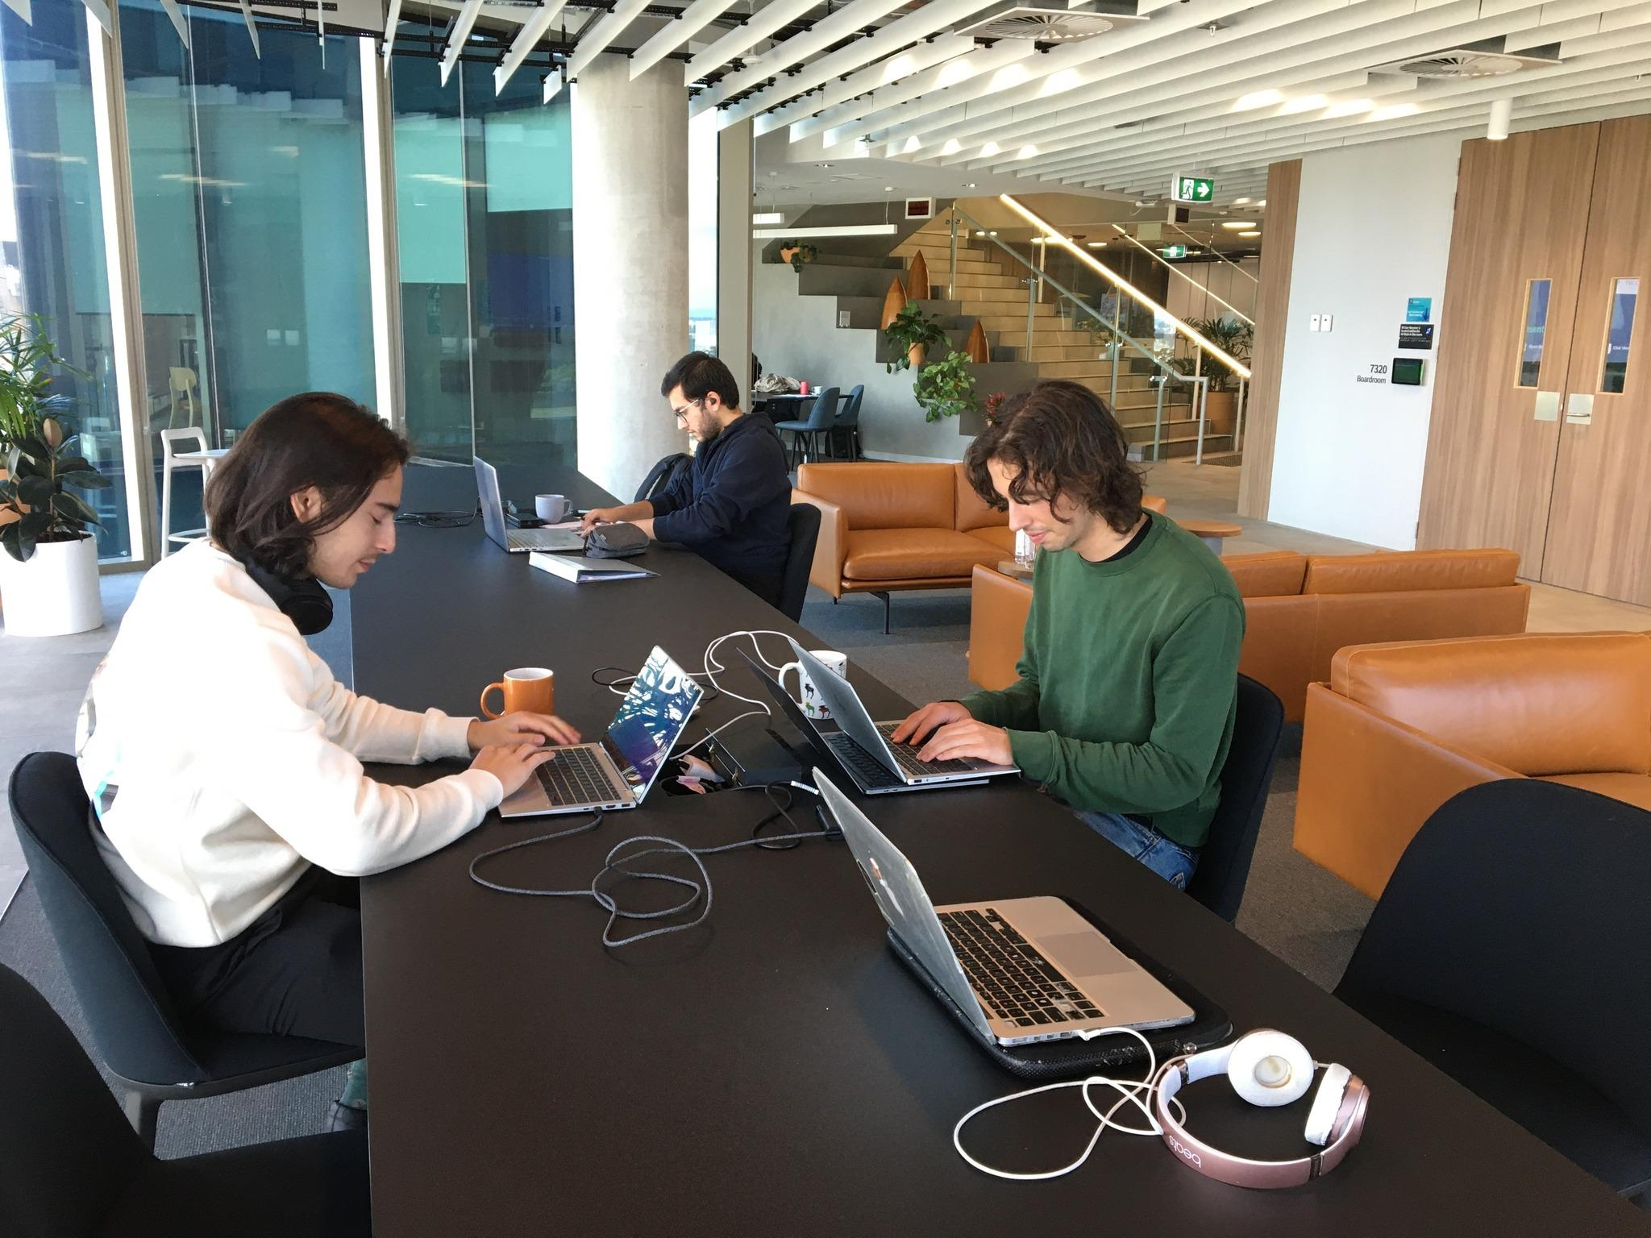
Shut Up And Write (SUAW)
Weekly sessions using the pomodoro method starting in March,
then weekly throughout the year
  25 minutes writing, 5 minutes chatting
  Held at the GSA building (1888 Building)
  Free coffee!
Join GRiPS at http://eepurl.com/cyaAsz

Slide 7
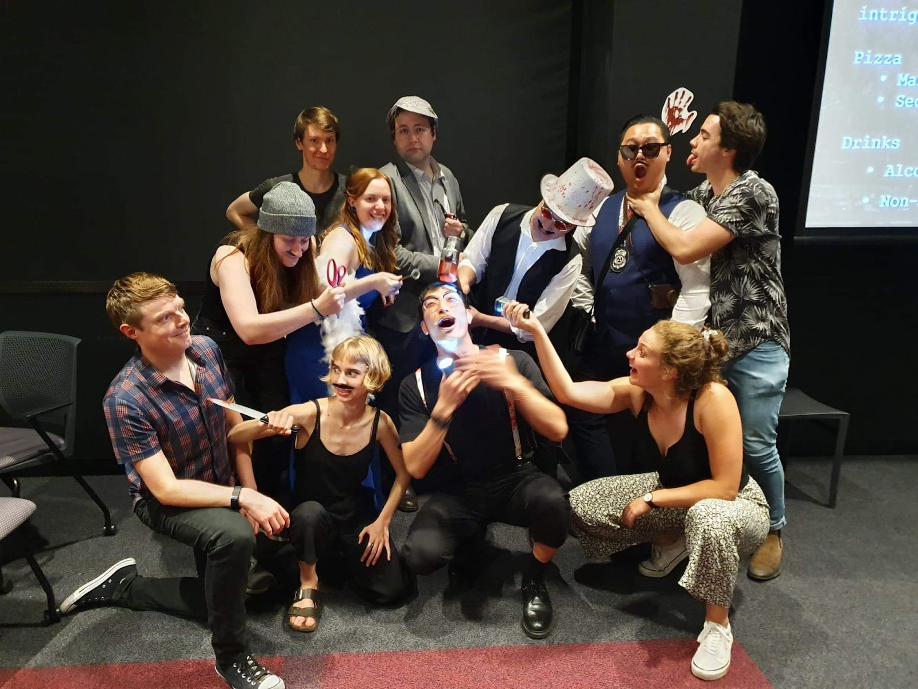
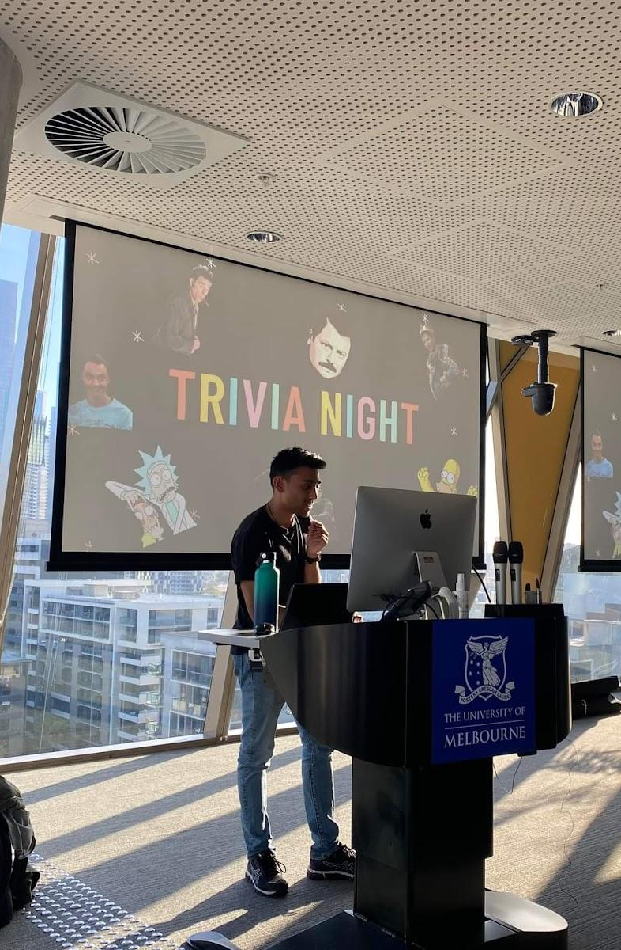
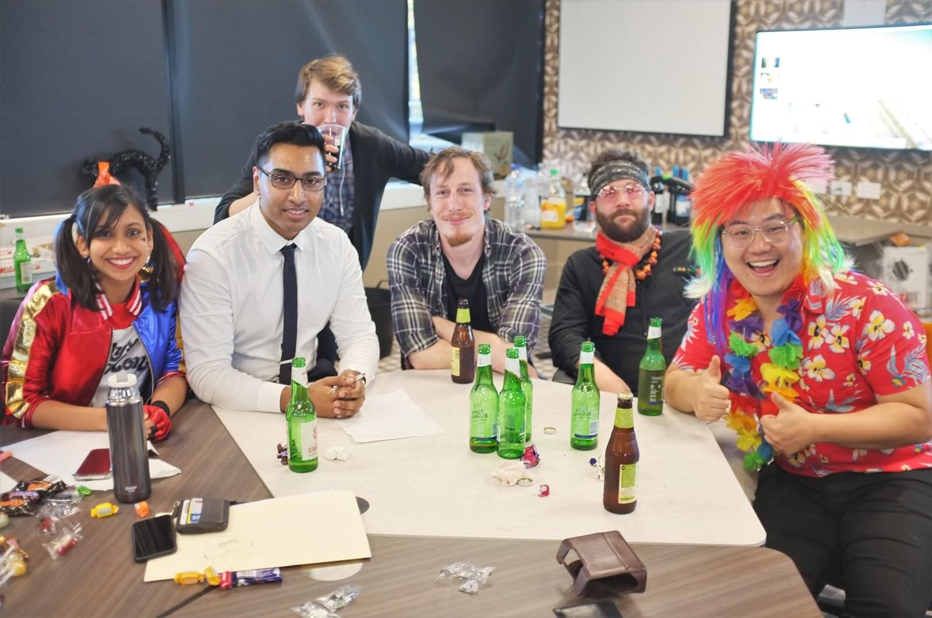
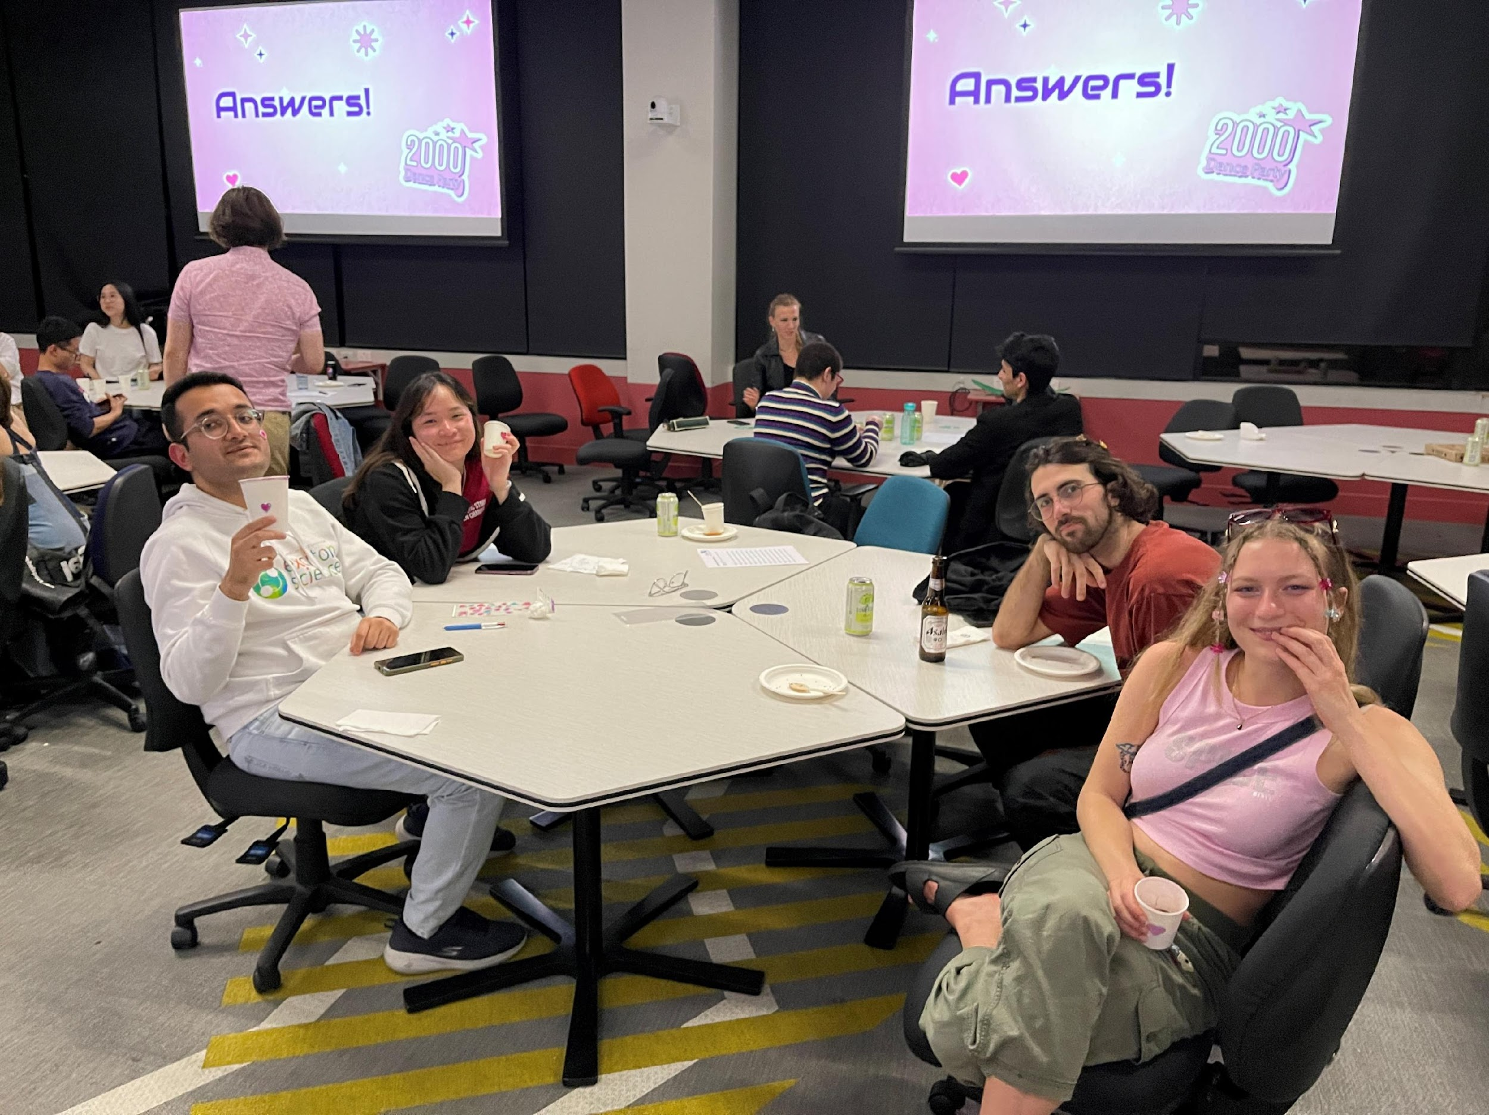
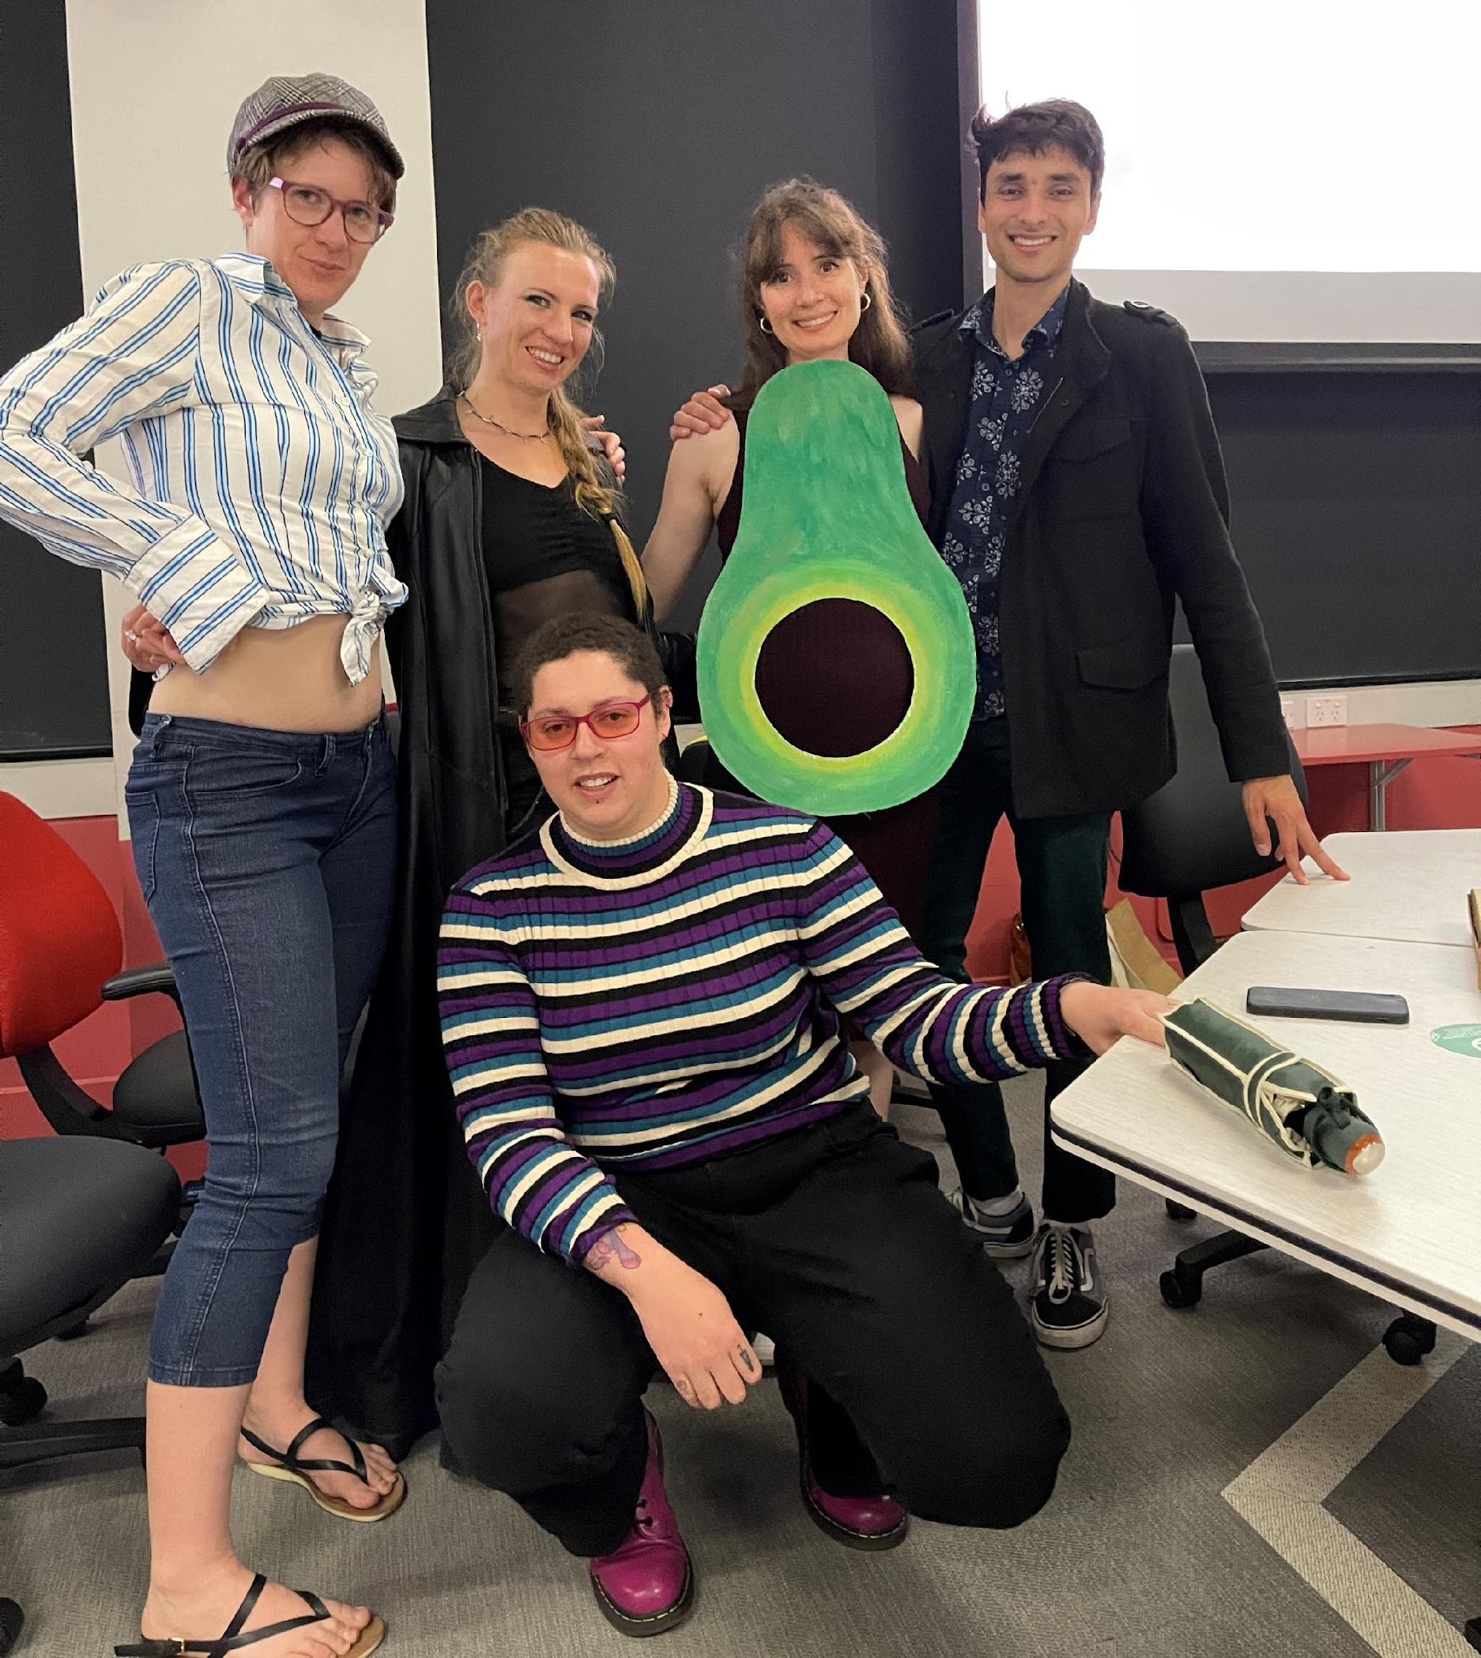
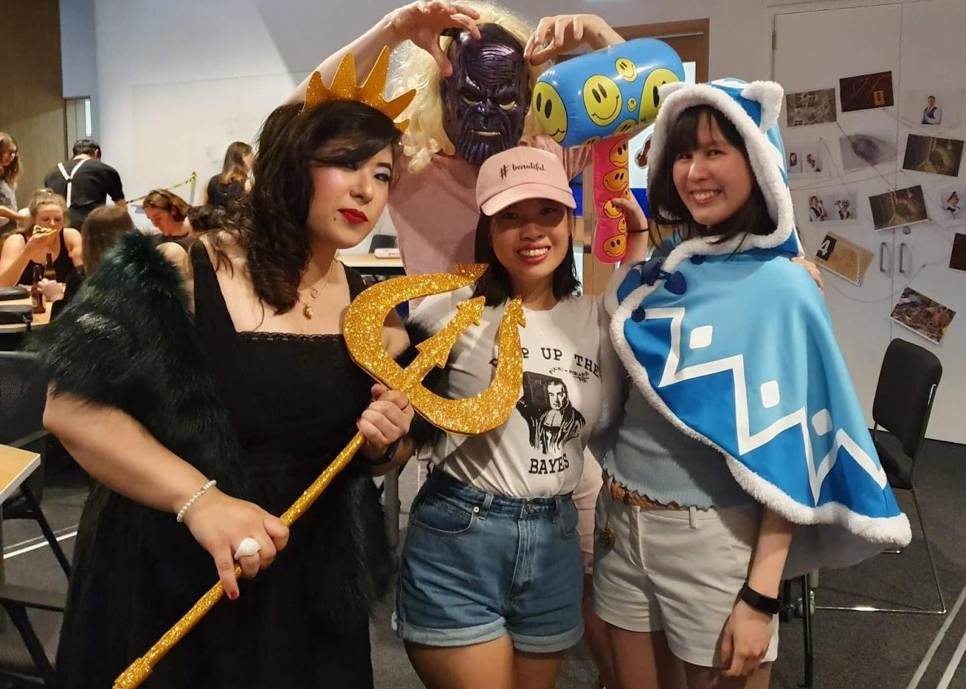
Trivia Night
Come test your trivia skills at our EOY trivia night (Semester 2)
Food & drinks provided
Dress theme TBD
    Past themes include y2k, sitcoms, and murder mystery
Prizes for all!
Actual prizes for winners
The prize of friendship
(& very useful knowledge) for
everyone else <3

Slide 8

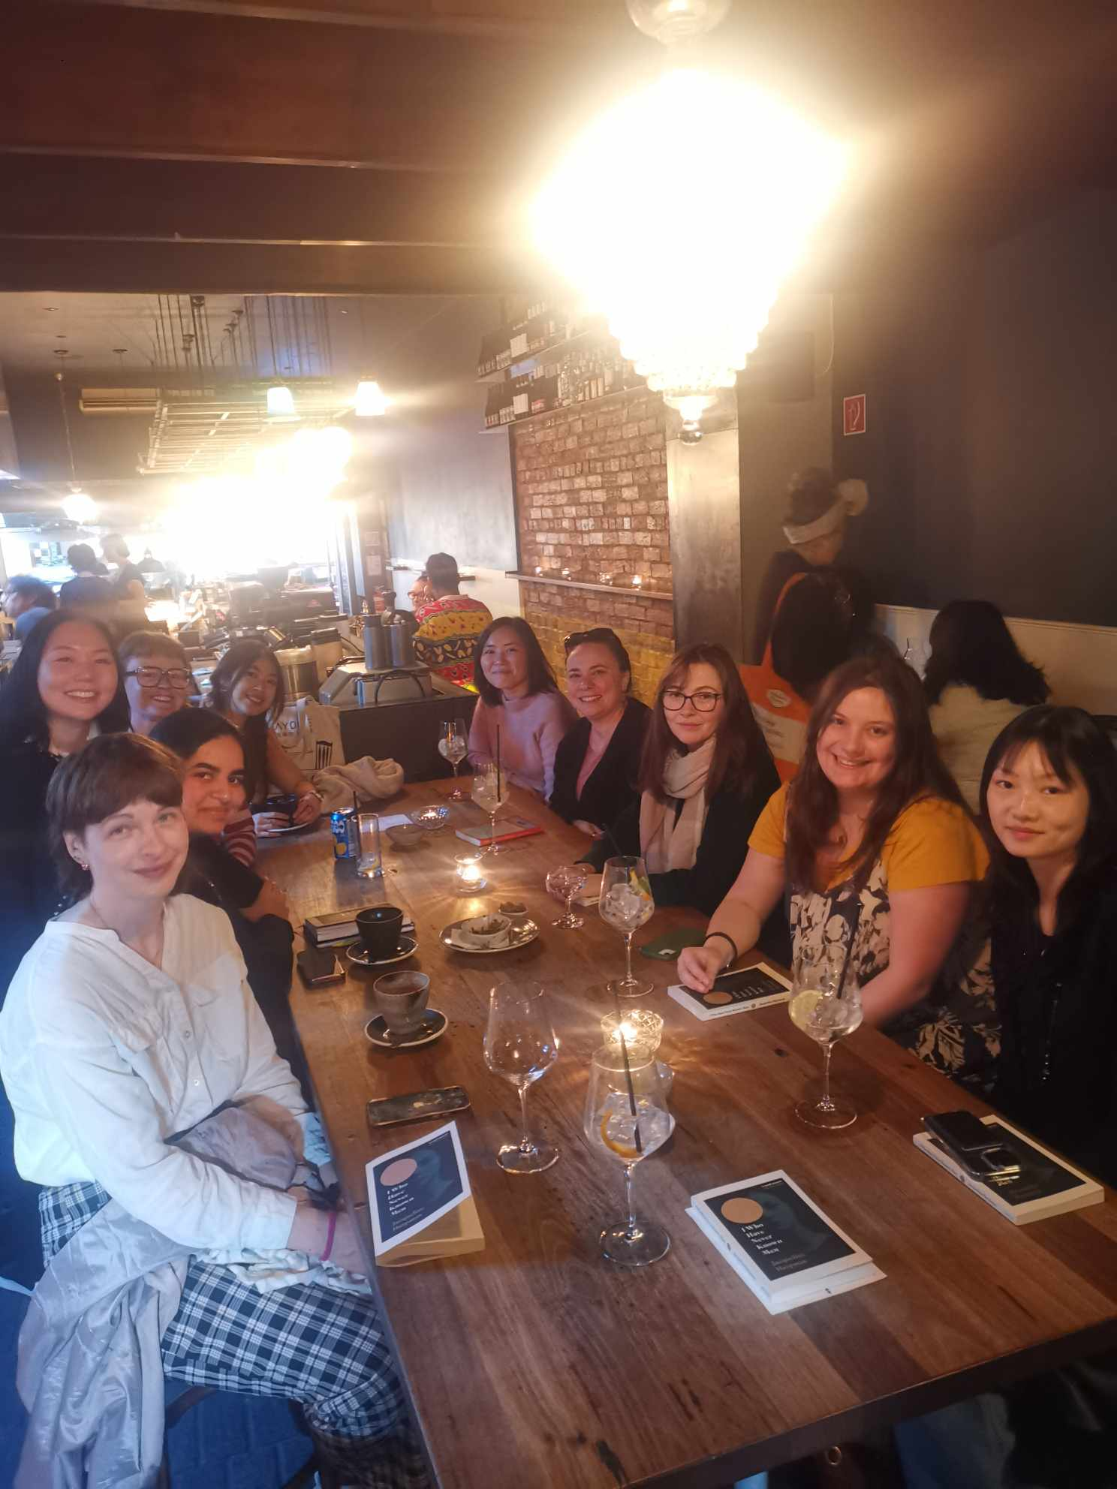


Book Club
?
Get back into reading (for fun) with the GRiPS book club…
    Meet ~4 times a year to discuss a book
    Food & drinks provided
    Books are chosen together by a vote
    Cost of books are reimbursed!

Slide 9

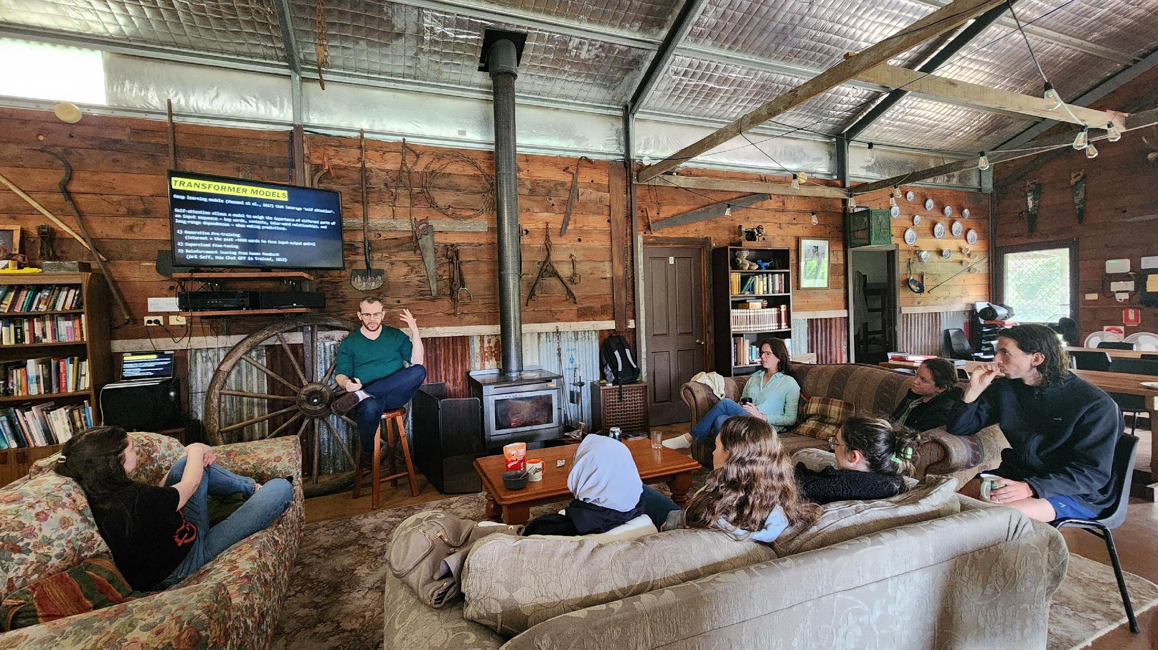
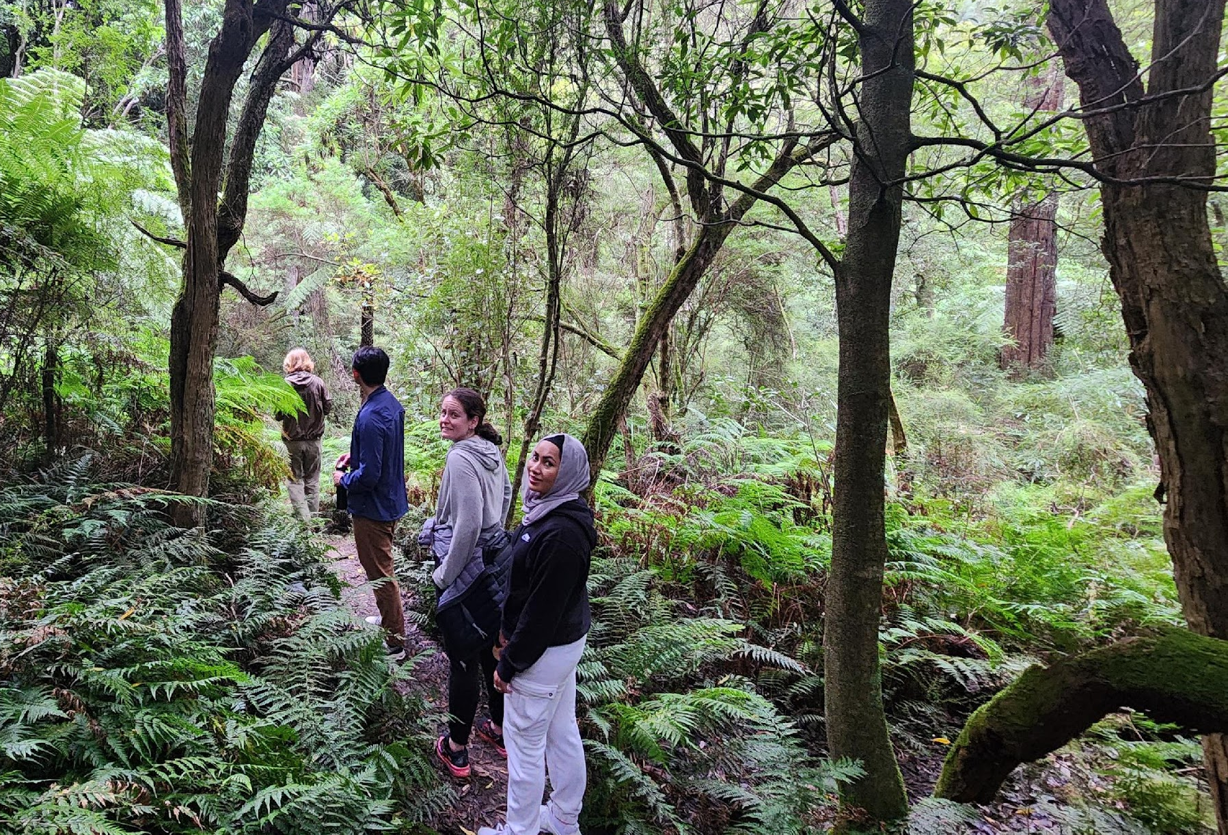
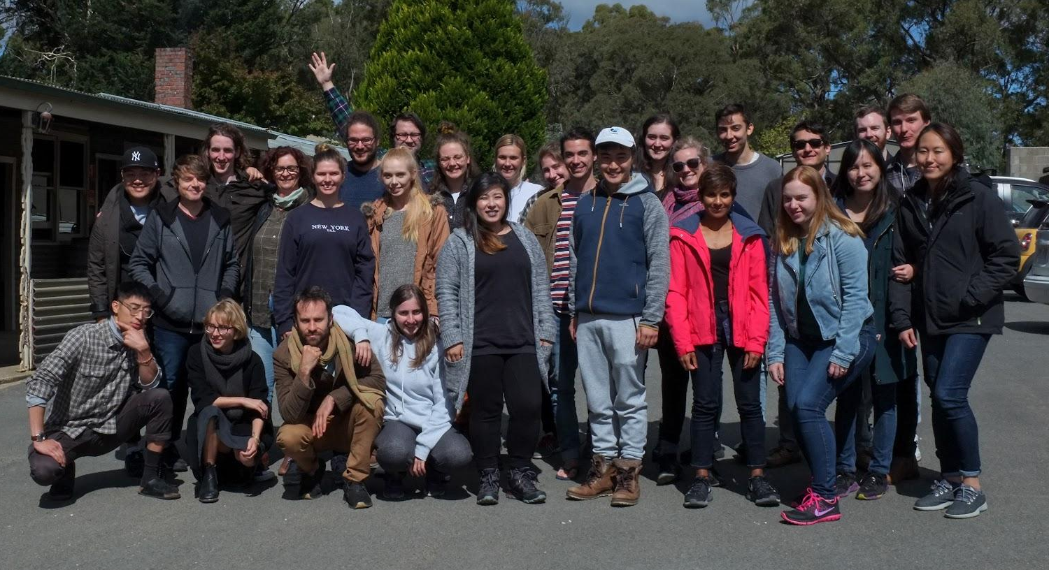
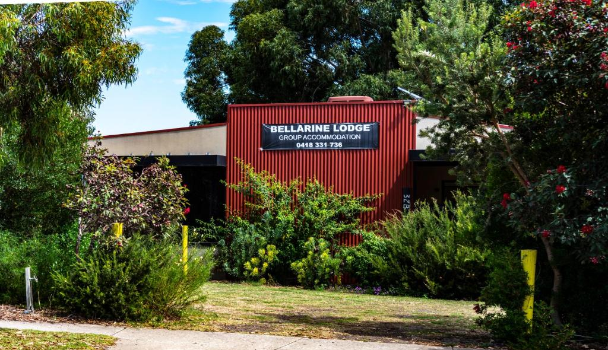
GRiPS CAMP
A relaxing weekend retreat for GRiPS members to connect with nature and each other
When: TBD - Second half of 2025
Location: TBD! Previous locations include Wilsons Prom, Bellarine Peninsula, & Phillip Island
Activities: Socialising, games, professional development workshops

Slide 10
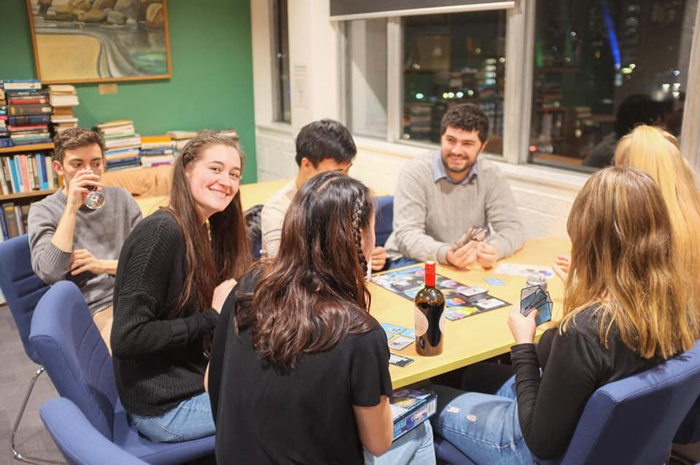

Other Hangs…
Come hang out at one of GRIPS’s monthly:
BOARD GAMES & CRAFTS
MOVIE NIGHTS
BYO Drinks
Pizza provided
Monthly
Location: Level 12 Kitchen, Redmond Barry Building
1 per semester, usually held on Thursdays
BYO Snacks
Movies chosen by vote
We hire out a whole cinema
just for us!
OPEN TO SUGGESTIONS: IF YOU JOIN AND HAVE SOMETHING YOU WANT TO OFFER AS AN ACTIVITY, WE CAN HELP MAKE IT HAPPEN!
Join GRiPS at http://eepurl.com/cyaAsz

Slide 11



JOIN GRIPS TO STAY UP TO DATE!
GRiPS (Graduate Researchers in Psychological Sciences)
https://www.facebook.com/groups/MUGRIPS/
@grips.msps
It’s FREE!
grips.msps@gmail.com
Join GRiPS at http://eepurl.com/cyaAsz

